Slide 1
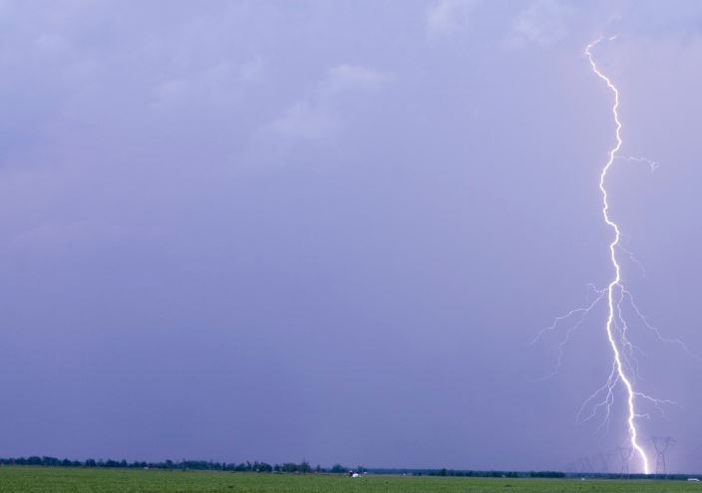
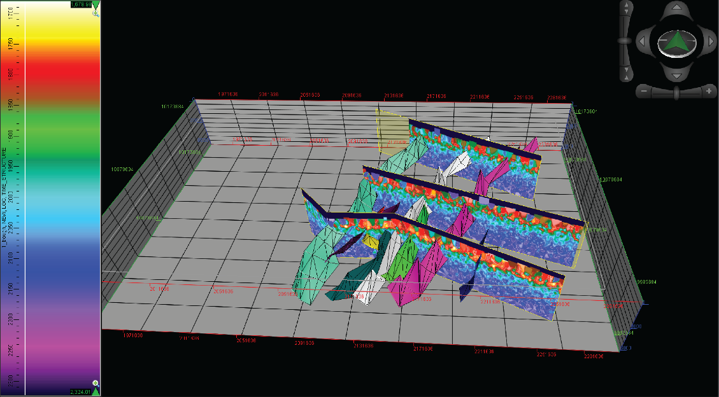
Lightning Analysis for creating geo-frameworks
SunCity RockOn Rock Club
12 October 2019
H. Roice Nelson, Jr.
Dynamic Measurement LLC
Notes:
This presentation summarizes the latest status of using a new geophysical data type – lightning strike data analytics – for mapping faults and identifying exploration sweetspots.

Slide 2
Career as geophysicist spent looking underneath the surface of the ground
Mobil Oil Seismic Crew in Mesquite in 1975 – High School Demonstration of Recording Truck – New York Times Science Writer
2003 The Leading Edge
1983 NTEG Translated to Chinese
1984 World Oil Cover
1991 O&G Journal Cover
2008 CSEG Recorder

Slide 3
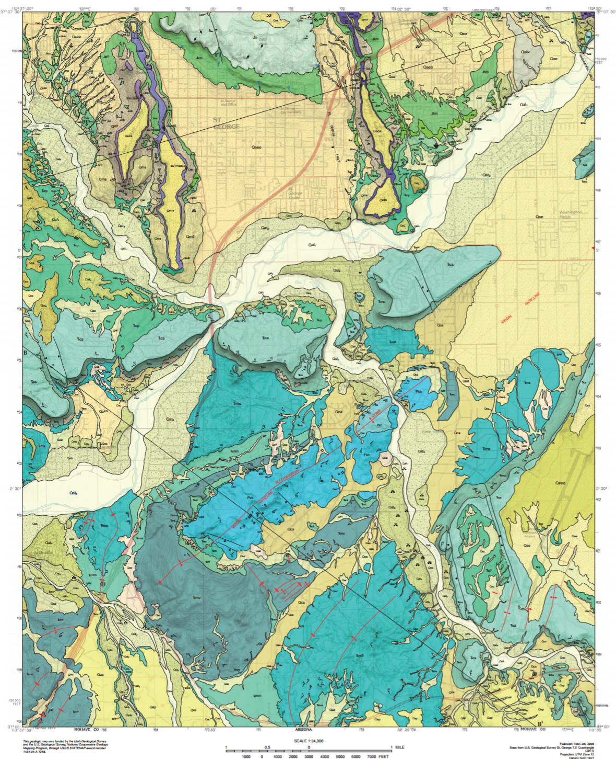
Identifying Places to Collect Unique Rocks, A Suggested Process:
Start with existing state geologic quads (this is the St. George Quad, ~ 60 square miles) or a 4-mile diameter SPOT^{sm} (12.57 square miles);
Purchase lightning data maps and volumes (~$60,000 for 60 square miles or $9,600 for SPOT^{sm} lightning analysis);
Map faults with potential hydrothermal alteration;
Integrate data types and local knowledge;
Go exploring in the field.

Slide 4
Lightning Density Maps show where to look for Lodestone

Slide 5
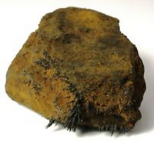
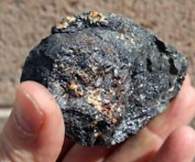
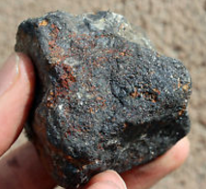
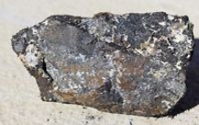
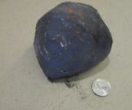
Lodestone Examples
Utah is a major source of iron ore and in particular, natural magnetic ore called lodestone or magnetite. These particular specimens both very rich in iron, making them magnetic.

Slide 6
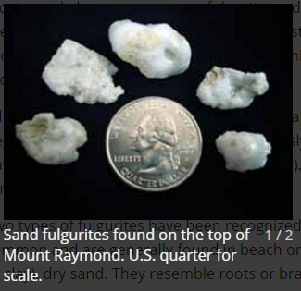
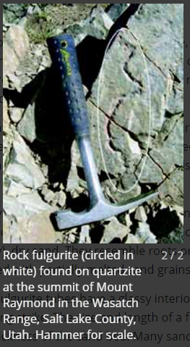
Fulgurites are fused sand from lightning strikes

Slide 7
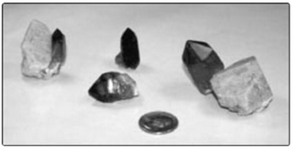
Smoky Quartz vugs tie hydrothermal alteration

Slide 8
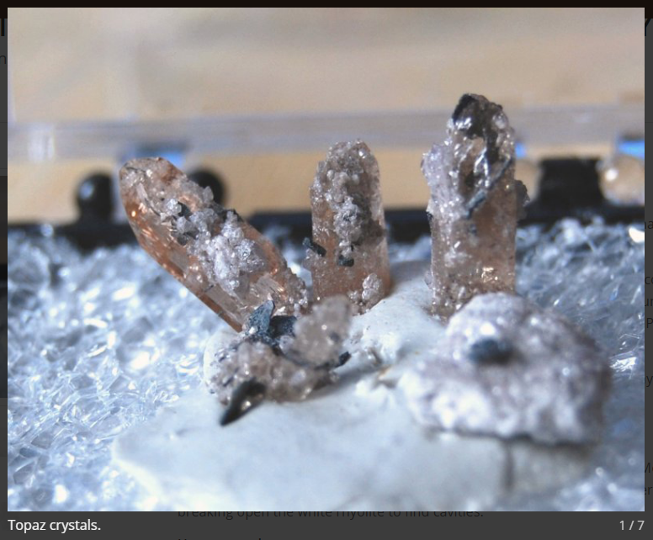
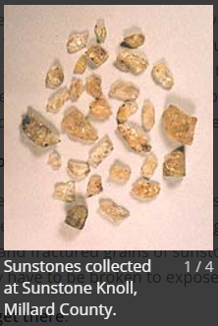
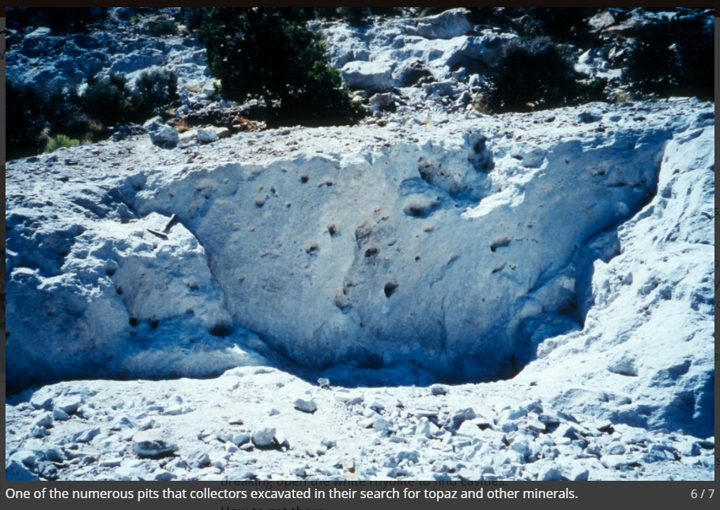
Sunstones and Topaz deposits are associated with lightning mappable underground geologic processes

Slide 9
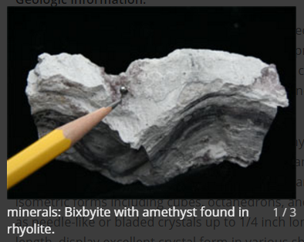
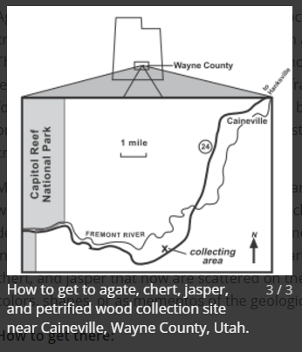
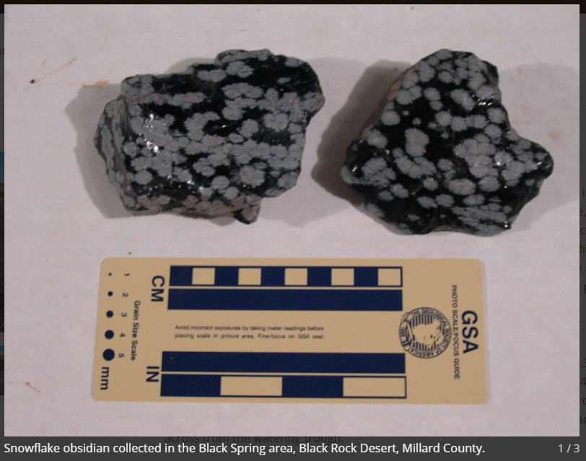
Predicting sites of volcanics, mineralization, & alteration

Slide 10
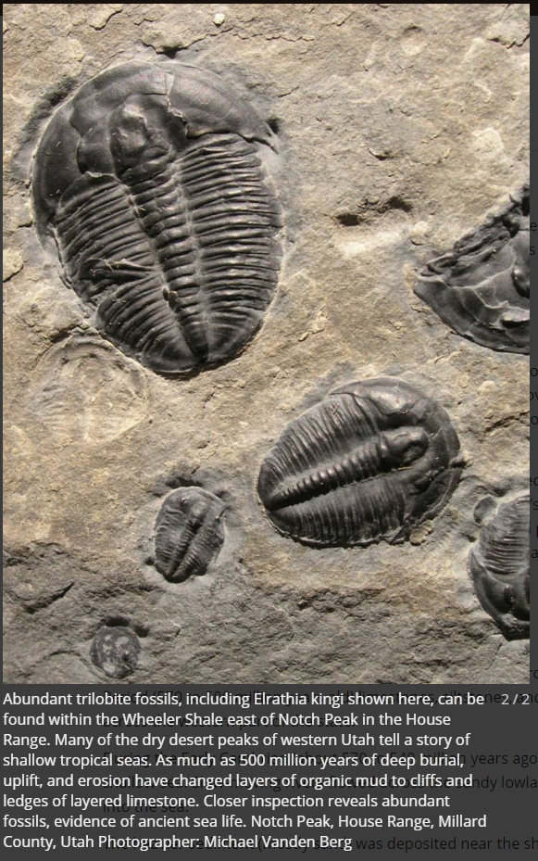
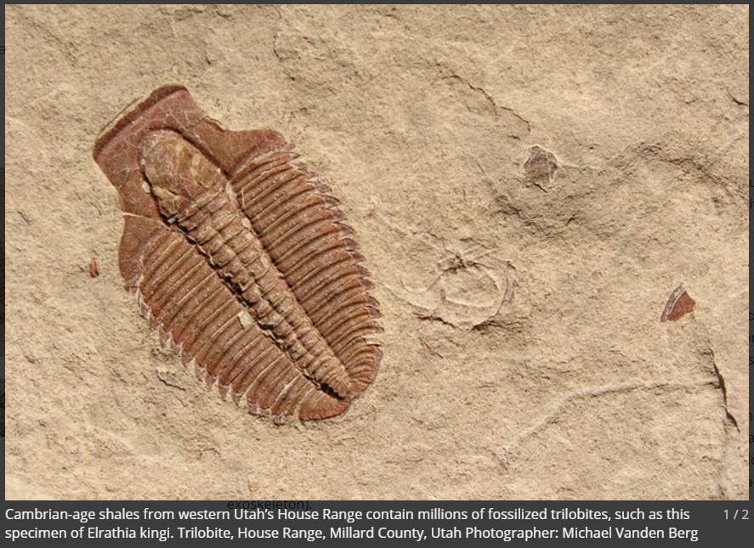
Where sedimentary rocks with fossils outcrop can be predicted from lightning volumes

Slide 11
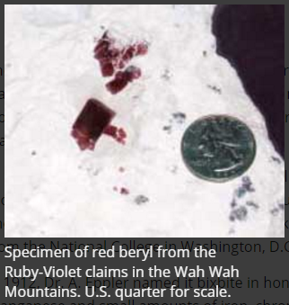
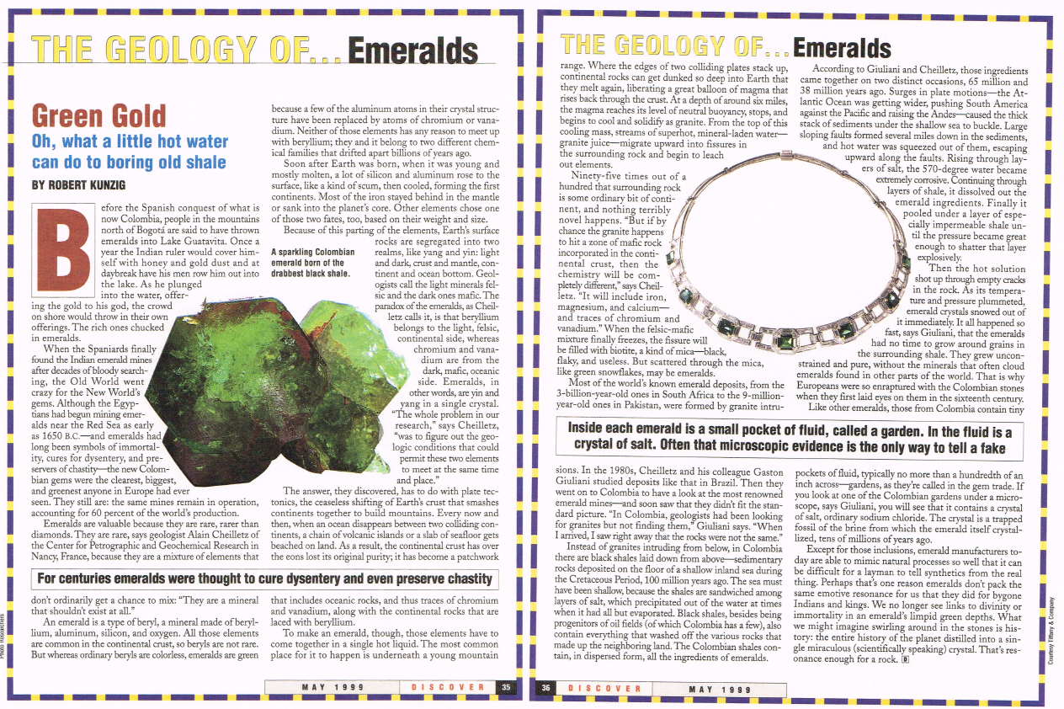
Red & Green Beryl are a direct result of hydrothermal alteration

Slide 12
Lightning Analysis Started with 2 Questions:
1. Can lightning hit twice at the same place?
2. Does this mean there is oil on my property?
Strikes from 1 storm (colors Peak Current ) 27 Sep 2011, Hockley Dome, Harris County, TX

Slide 13
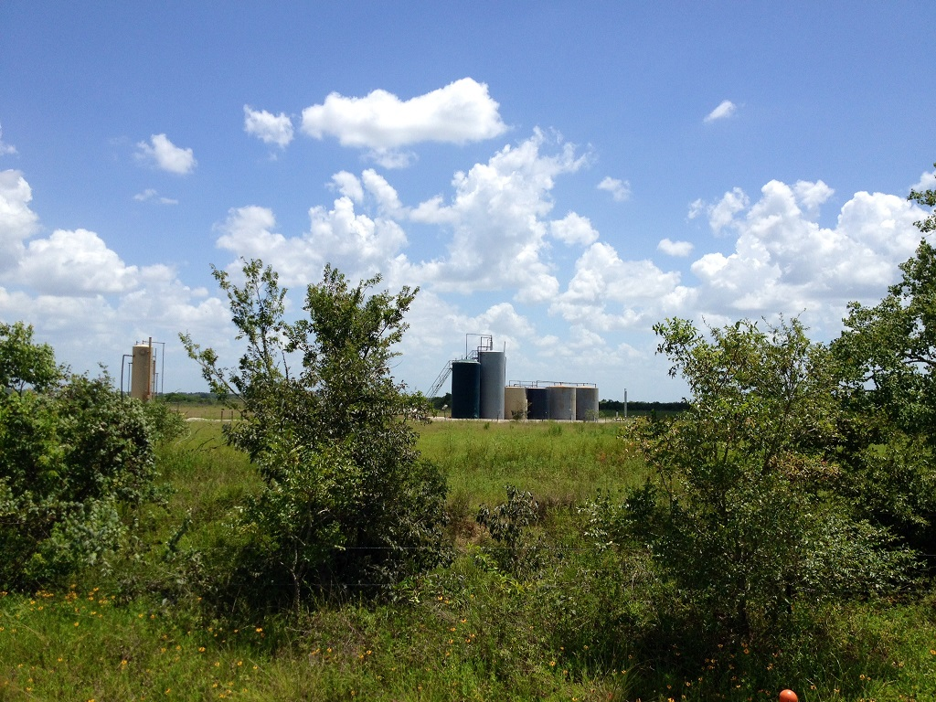
The Answer to Both Questions is Yes!
The answer to the first question is “yes,” lightning strikes cluster and the clusters are consistent over time.
The answer the second question is “there is oil here,” as shown by the tanks now at the location of the lightning strikes raising the questions.

Slide 14
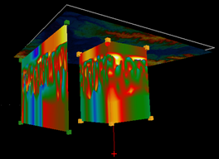
Presentation Outline
Milam County Texas apparent-resistivity Volume
Introduction and Context
Lightning Occurs Everywhere
Lightning Database Analytics
Lightning Analysis & Attributes
Rock Property & Attribute Maps & Volumes
Texas, Louisiana, Michigan, Arizona, California, Utah, & Nevada Examples
Notes:
The presentation is divided into 5 sections, as listed above.

Slide 15
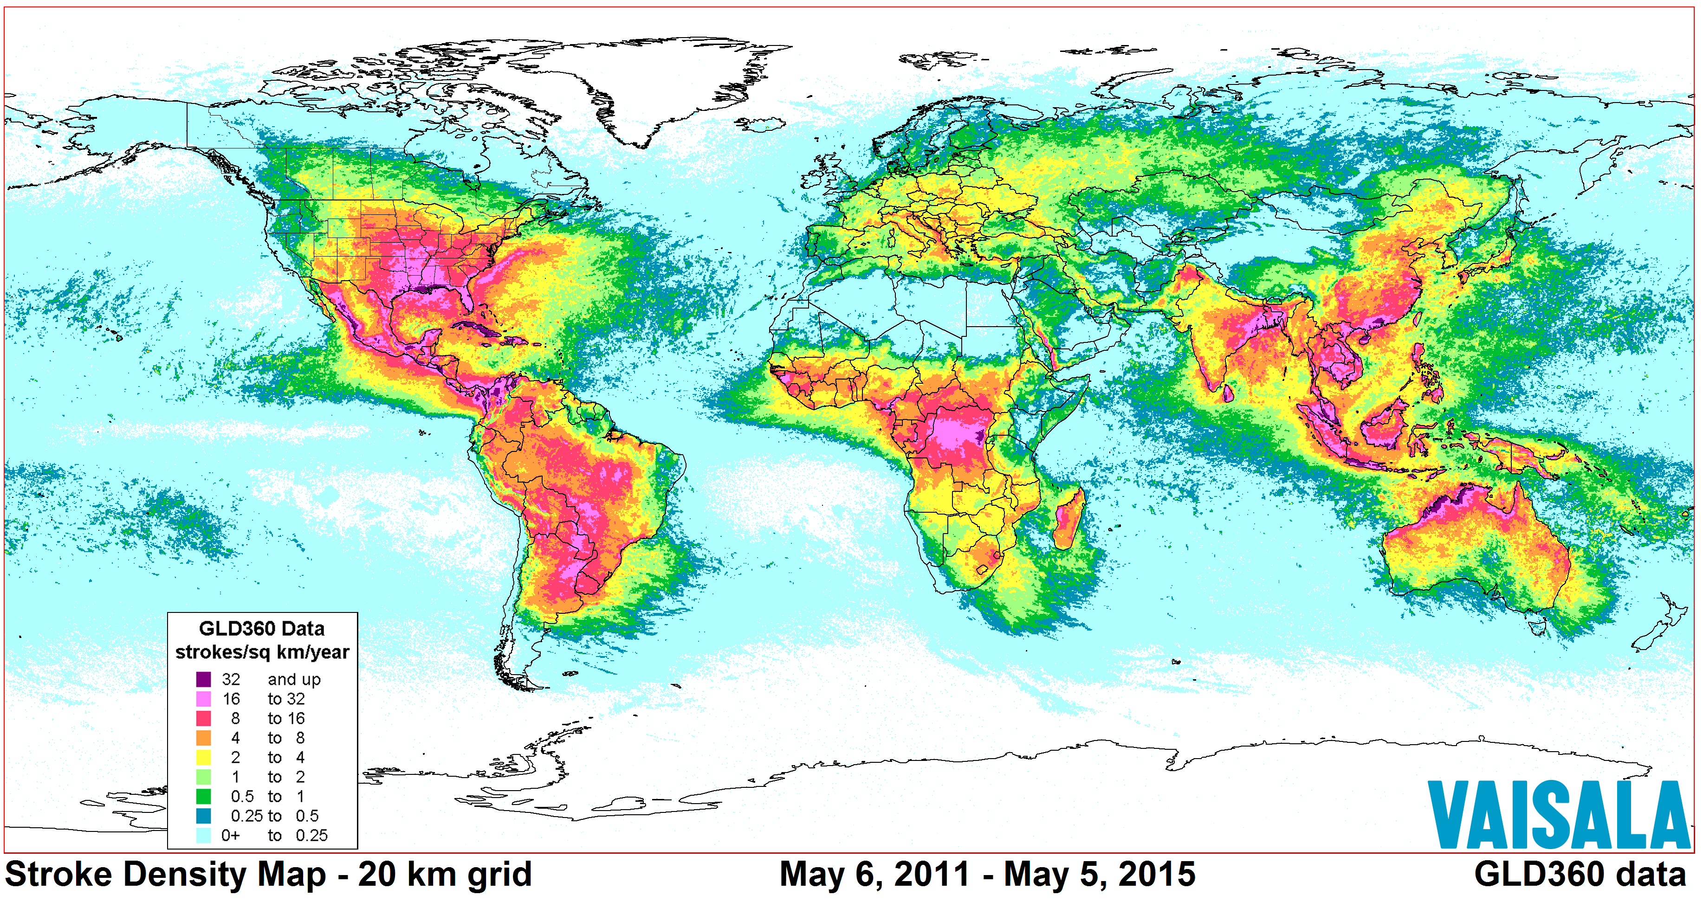
1. Lightning Occurs Everywhere 8+ years of data in GLD-360 database
Notes:
Lighting occurs everywhere, as shown in this worldwide map of lightning density. This data is from Vaisala’s private GLD-360 (Global Lightning Database), which has been collecting data for the last 5 years. GLD-360 data is based on VLF (Very Low Frequency) sensors, and has less resolution than data collected LF (Low Frequency) sensors. It also does not include some of the attributes collected with other lightning detection networks.

Slide 16
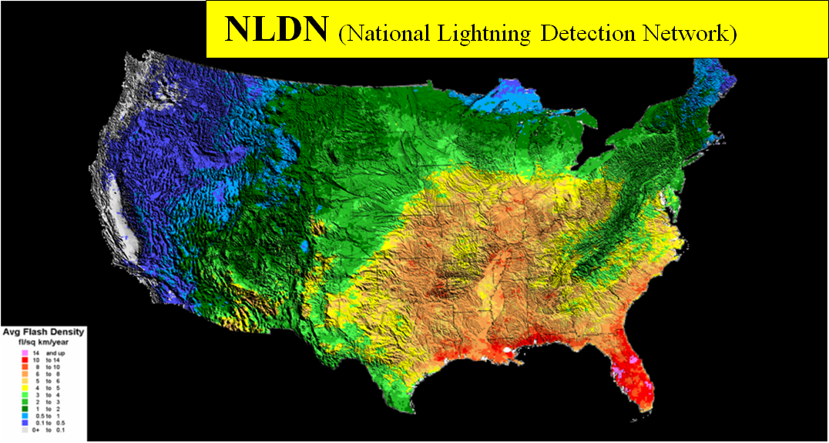
The U.S. has the most complete database 20+ Years of Data in the NLDN Data Base
Originally Collected for Insurance, Meteorology, and Safety Reasons
Notes:
The North American Lightning Detection Network (NALDN ) is comprised of the private National Lightning Detection Network (NLDN) shown above, and the public Canadian Lightning Detection Network (CLDN) in Canada. This network of sensors was started in the early 1980’s, approximately the same time we started Landmark Graphics Corporation. Dr. Richard Orville, who was a professor at the University of New York at Albany and who proved it was possible to triangulate lightning strike locations, explained how interesting this data was to insurance companies. At the time, about 60% of insurance claims on houses people said were burned down by lightning were fraudulent or misrepresented. Today the NLDN is mostly funded by insurance, meteorology weather forecasting, and airport and golf course safety industries. The map above shows the density of lightning strikes recorded by the NLDN. Note the low density of strikes across the Snake River Plains volcanic flows. This is an example showing there is a relationship between geology and lightning strike locations.

Slide 17
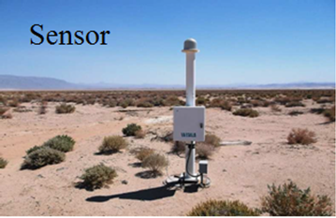
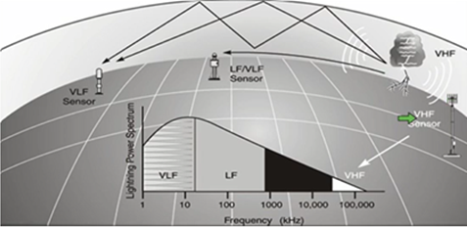
Sensors Measure Direction to Strike & Lightning Attributes Strike Triangulated & Measurements Reconciled
Vaisala: Martin Murphy
2016 Webinar used with permission
Notes:
The VLF/LF sensors used to record lightning strike attributes are about 6 feet tall. When there is a lightning strike, it sends out an electromagnetic pulse. The clicks you have heard on an AM radio during a lightning storm are lightning strikes. The sensors measure magnetic inclination to give the direction. Direction coupled with time allows locations to be triangulated.

Slide 18
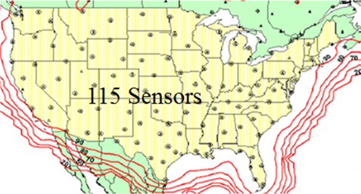
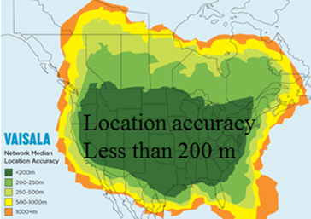
Vaisala’s NLDN Lightning Detection Network
In Texas 12-24 sensors record each lightning strike
Location Accuracy:
150-600 feet
Lineament Accuracy:
10-100 feet
From 2016 Vaisala Webinar: Martin Murphy,
used with permission
Geophysicists have used passive gravity, magnetic, and seismic measurements to understand the subsurface of the earth for decades. Using existing lightning strike databases expands this work.
Notes:
There are 115 lightning detection sensors in the NLDN, providing coverage across the continental United States. These sensors have a flash detection efficiency of over 95%. Horizontal accuracy is published as being less than 200 meters, and Dynamic Measurement has demonstrated this accuracy can be 50 meters or even 5 meters in some cases. This means the horizontal accuracy of lightning strike locations is similar to the trace location accuracy for a 3-D seismic survey. A typical lightning strike in Texas is recorded on 14 to 24 sensors, where some of the sensors are more than 300 miles away.

Slide 19
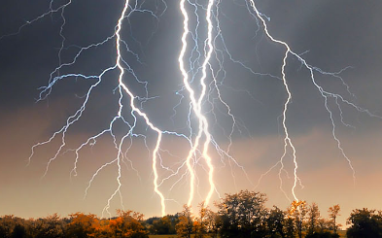
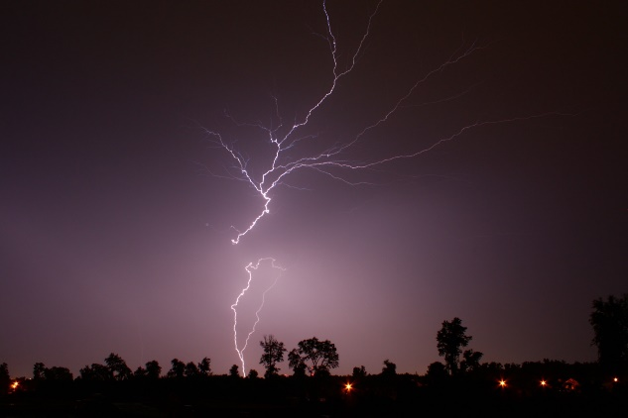
2. Lightning Database Analytics
Typical projects have millions of lightning strikes.
To date all projects have tied subsurface control.
Attributes are measured or calculated for lightning strike locations, then contoured or gridded.
Lightning strike density and attribute values cluster, and these clusters are somewhat consistent over time, allowing the data to be stacked.
Lineaments, like fault scarps, have been mapped with 30 foot horizontal location accuracy.
Notes:
A 214-square-mile lightning analysis projects in the Gulf Coast, where there are on average 26 lightning strikes per square mile per year, has 1,000,000 lightning strikes in the 18 year NLDN evergreen database. A project of the same size in the deserts of California will have 150,000 lightning strikes in the NLDN database. The results from datamining these amounts of data are remarkably good. Each project Dynamic Measurement has done to date ties available subsurface control. This is because, even though each lightning strike is different because of meteorological factors, the geology is consistent over time. Yet near surface soils change with water saturation. However, it is the geology beneath the weathering layer, which is where the telluric currents are, which impacts lightning strike locations. Remember, lightning is coming from 5,000 to 25,000 feet in the atmosphere, and water saturation from a rainstorm only impacts the first few feet of the weathering layer. The fact that lightning strike density and lightning strike attribute values cluster, and these clusters are somewhat consistent over time, shows geologic control. Also lineaments, like fault scarps and stratigraphic pinchouts, have been mapped with 30 foot horizontal accuracy.

Slide 20
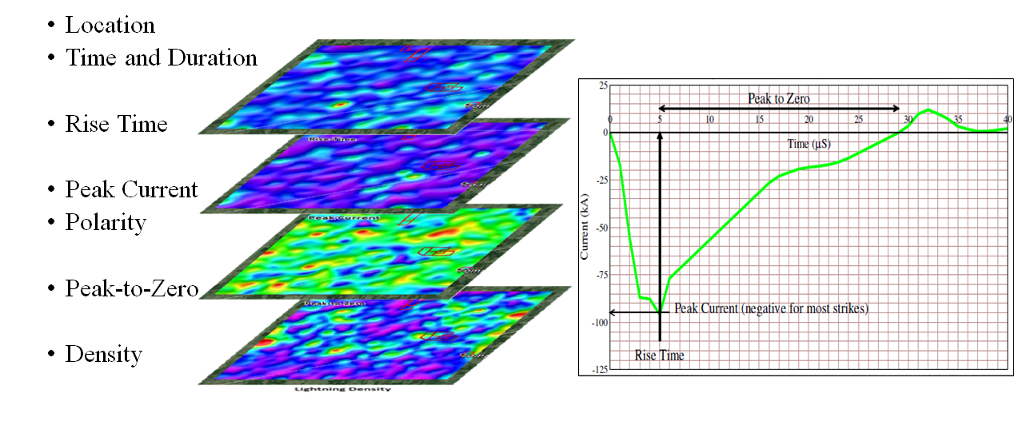
Lightning Measurements
Other attributes calculated from these measurements.
The time of the lightning strike is correlated with solar and lunar tides.
Measurements separated by time.
Notes:
A pulse of energy travels out from each lightning strike. Data related to these pulses are collected by NLDN sensors and automatically combined to give a single set of recordings for each lightning strike. The sensors measure the beginning of an event to the nearest micro-second (10⁻⁶ seconds). The sensors have a magnetic inclination, which gives the direction of the pulse. Triangulating these measurements, somewhat similar to the way earthquake locations are triangulated from multiple sensors, provides a location. Rise-Time starts once the electrical energy exceeds the background electrical noise on multiple sensors for a specific time. Rise-Time ends with Peak Current. This Peak Current has polarity and can be positive or negative. Most lightning strikes are negative, and come from the base of clouds forming a thunderstorm. Positive strikes tend to come at the end of a storm and to come from the top of the clouds. Peak-to-Zero is the time from Peak Current to when the energy returns to the background electrical noise. These values are gridded, averaged within cells, and mapped to create the top three maps above (Rise-Time, Peak Current, and Peak-to-Zero). These maps were generated for a project in Michigan. The bottom map above is generated by counting the number of strikes which occur in a specific sized grid cell, and summing this number to create a map of lightning strike density.

Slide 21
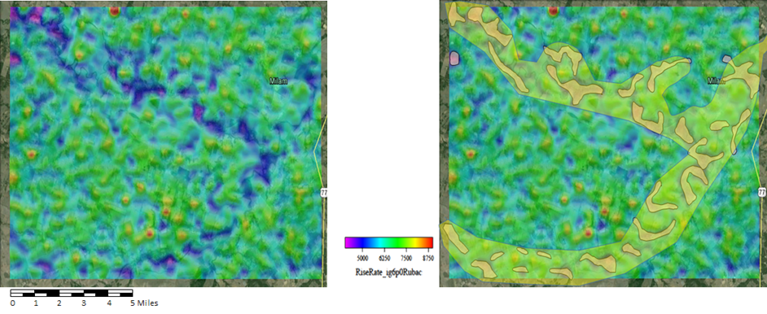
3. Lightning Analysis & Attributes
Analysis area selected.
Patented Processes produce maps and volumes of derived rock properties and lightning attributes.
Existing geology and geophysics integrated with new data.
Lightning Attribute: Rate of Rise-Time – Milam County, Texas
Notes:
The Lightning Analysis Process starts with selecting an area to evaluate. Lightning data is ordered over this area. Once the data are received, a series of patented, patent-pending, and trade-secret processes are run on this data to clean the data and produce rock property and lightning attribute maps and volumes. The left map above shows the rate-of-rise-time (first derivative of the Rise-Time) over a project area in Milam County, TX. An interpretation of this area shows probable near-surface point bars close to the surface where the confluence of two rivers in Milam County occurs. Once the maps (xyz, pdf, and kmz files) and volumes (SEG-Y or voxel ASCII files) are generated, the lightning-derived data are loaded into a standard geophysical workstation and integrated with other available data like wells, seismic, gravity, and aeromagnetics.

Slide 22
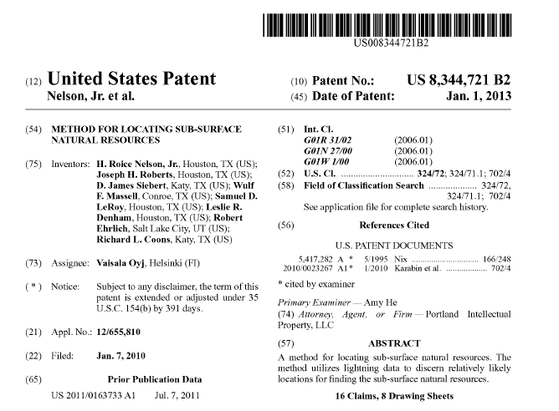
Dynamic Measurement LLC Patent 1 Method for locating sub-surface natural resources
Natural Resources defined as:
Diamonds;
Other Gemstones;
Gold;
Silver;
Copper;
Other Minerals;
Geothermal Deposits;
Oil;
Gas;
Water; &
Other sub-surface natural resources sharing inherent similarities.

Slide 23
Dynamic Measurement LLC Patent 2 Method for determining geological surface and subsurface resistivity

Slide 24
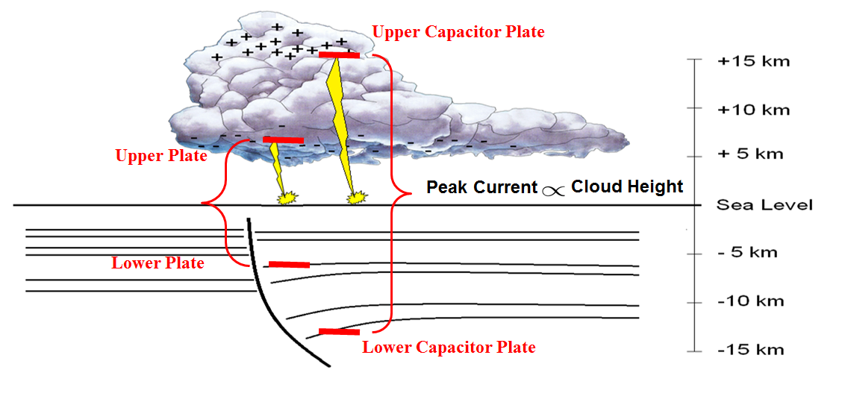
4. Rock Property & Attribute Maps & Volumes
Key Assumptions: 1. Lightning occurs when there is sufficient charge to bridge the capacitor. 2. Lightning is affected by geology to a depth proportional to cloud height, as derived from Peak Current
Notes:
Many assumptions are made when developing a new geophysical data type. We assume the strike locations are correct. We have demonstrated this visually and with calculations tied to radio towers and surface cutting faults. We assume there is a relationship between the geology and the recorded lightning attributes. This is demonstrated with map results. To calculate a depth component influencing recorded data, we first assume the Peak Current is proportional to the height of the cloud, which height is the capacitor distance the strike must bridge. The atmosphere is a very good insulator, with an electrical conductivity of 0.03-0.08 * 10⁻¹⁴ Siemens per Meter. Assuming a typical sedimentary rock has 5% porosity, the electrical conductivity of rocks is 5.0 * 10⁻⁴ Siemens per Meter, or about 10¹⁰ times the conductivity of air. It takes more Peak Current to bridge a larger capacitor distance. Our second assumption is that the depth telluric currents are influencing electrical currents in the atmosphere is mirrored around the surface of the earth.

Slide 25
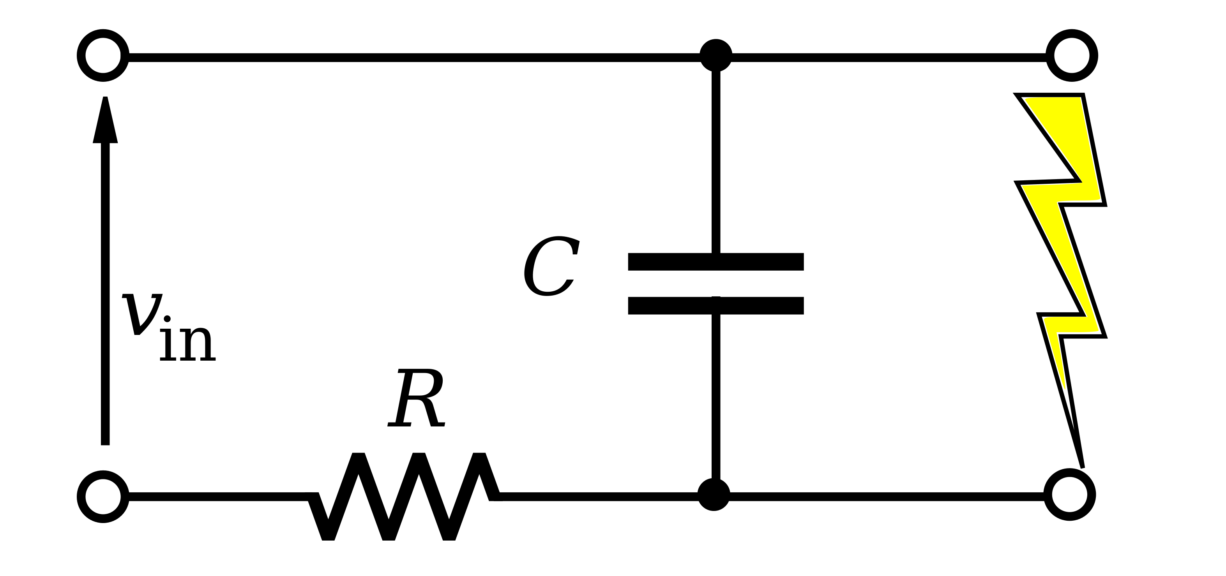
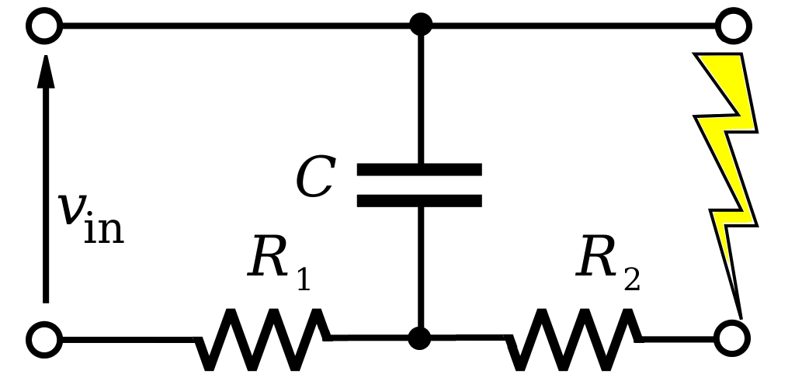
Relaxation Oscillator Physics and Lightning (a giant neon tube)
The atmospheric capacitor is like a relaxation oscillator
Just an additional resistance (R₂) limiting the current
R₂ is the resistance between the lightning strike point and the bottom plate of the capacitor
Notes:
One way to look at this is that a lightning strike is like current flowing along a wire. There is a magnetic field generated orthogonal to the flow of current. These currents are gigantic, on the order of 5 to 50 thousand amperes. The magnetic fields are what charge and interact with telluric currents in the subsurface, all the way to the Mohorovičić discontinuity. In terms of physics, lightning strikes can be compared to a relaxation oscillator, or a giant neon tube. With a neon light, current is built up from an input voltage until it flows through a resistor and builds up sufficient charge to bridge a capacitor. With lightning, there is an additional resistance, the resistance in the earth between the strike plate and the bottom plate of the capacitor, which is R₂ in the diagram. R₂ is calculated as the apparent resistivity in the lightning relaxation oscillator circuit. We can place this calculated value at the surface, and average the values with a specified cell size to create a rock property map of apparent resistivity at the surface. Alternatively, we can place this calculated value in the subsurface at a depth proportional to the cloud height (Peak Current), and then placing thousands or millions of points in the subsurface, interpolate between them to create an apparent-resistivity rock property volume.

Slide 26
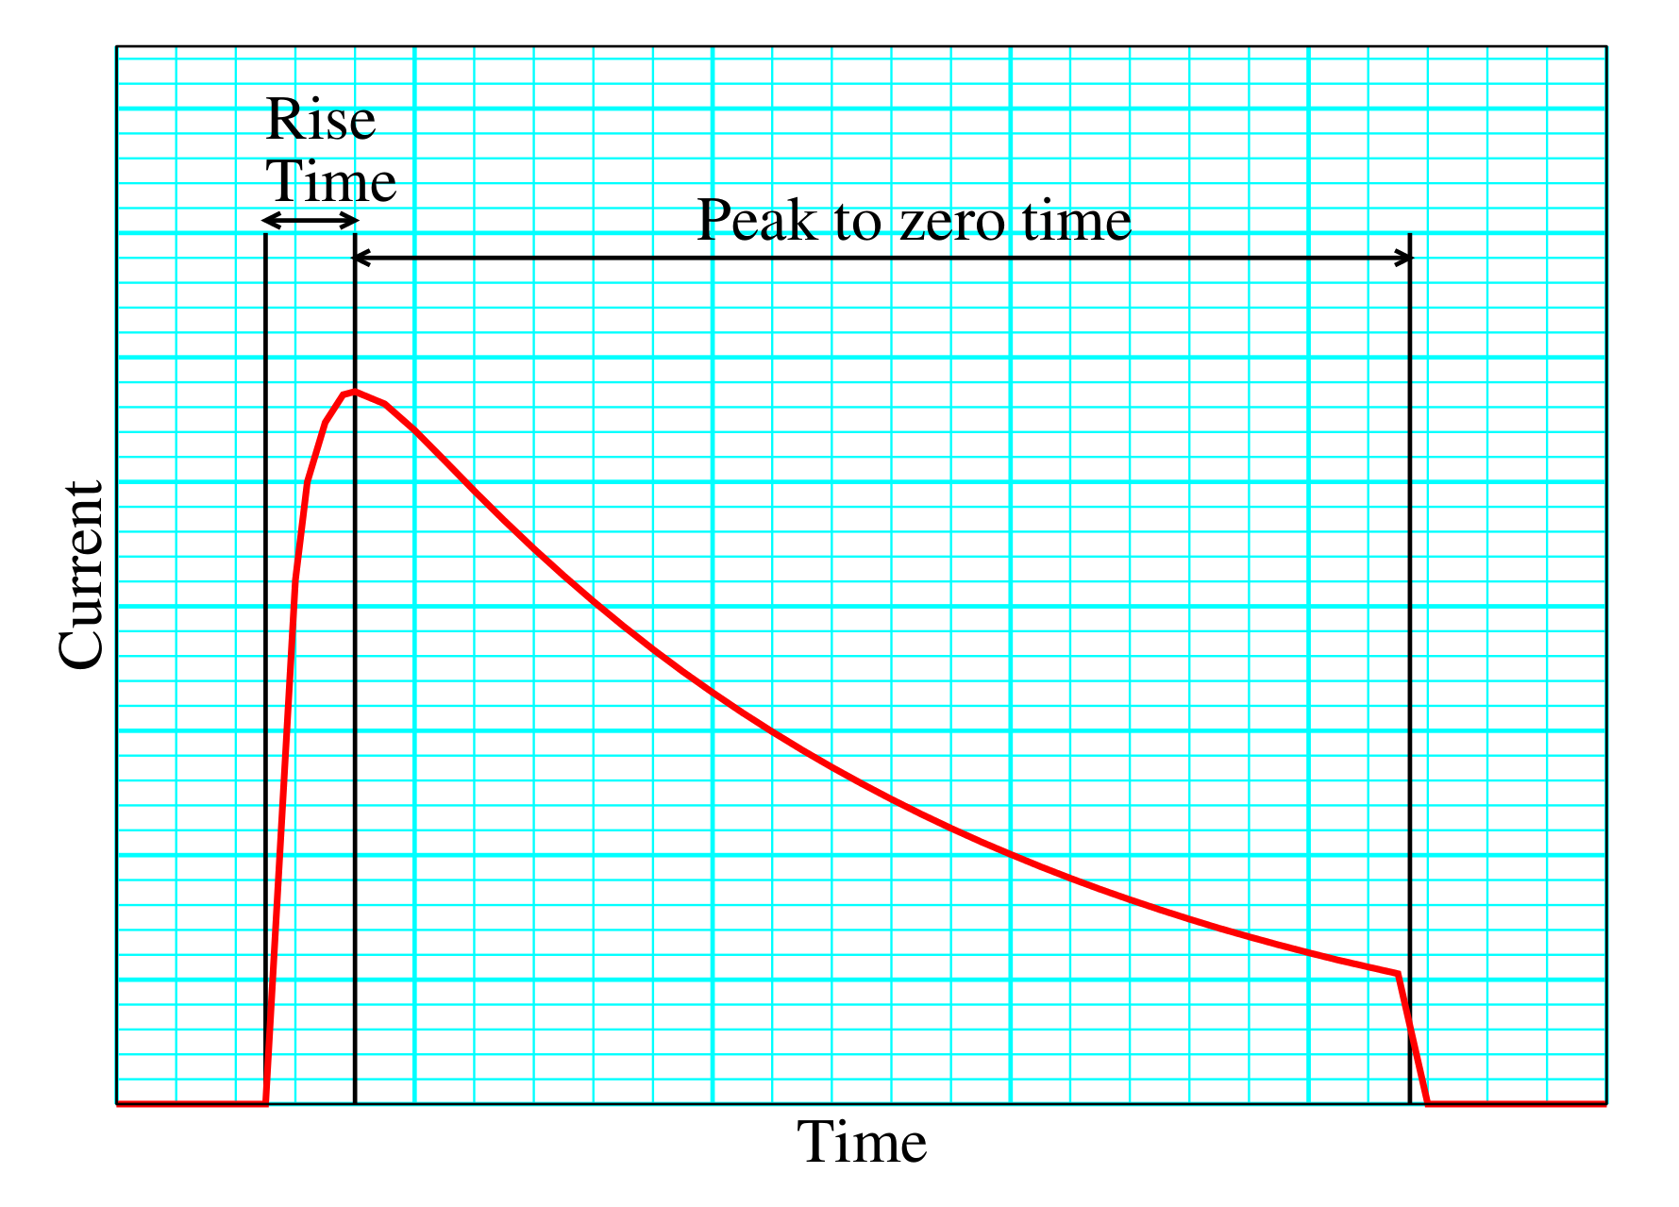
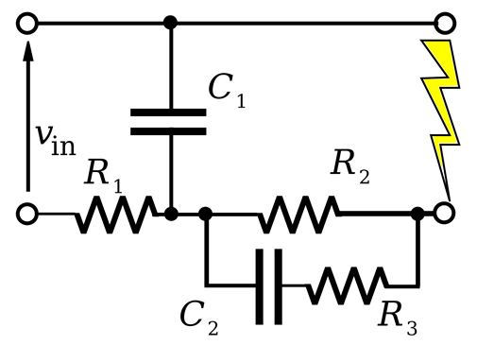
Lightning and the Induced Polarization Effect
Lightning does not have a square waveform
But it does have a very steep onset
Variations in the onset as measured (rise-time) show the IP Effect
By treating this steep onset as charging a capacitor (C2) through a resistor (R3), an apparent capacitance can be calculated.
From the apparent capacitance a value for apparent permittivity can be calculated
Notes:
These concepts can be extended to calculate another rock property, apparent permittivity. The IP, or Induced Polarization effect, is an exploration method measuring the slow decay of voltage in the ground following the cessation of an excitation current pulse. This decay is due to the permittivity, or the capacitivity of 3-dimensional materials. Typically, the excitation current pulse is a square waveform. Lightning does not have a square waveform, but it does have a very steep onset. Variations in this steep onset are measured as Rise-Time, and show the IP effect. By treating this steep onset as the charging of a capacitor (C₂) through a resistor (R₃), an apparent capacitance can be calculated. From the apparent capacitance, a value for apparent permittivity can be calculated. These values can be averaged within grids at the surface to create maps of apparent permittivity, or placed in a position relative to their position in the subsurface, and interpolated to create an apparent permittivity rock property volume.

Slide 27
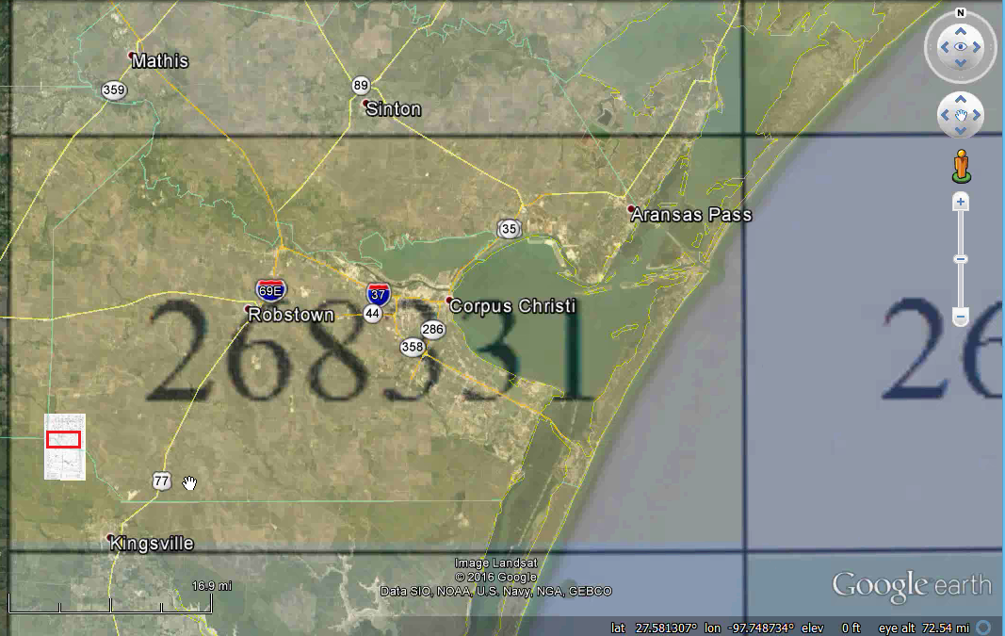
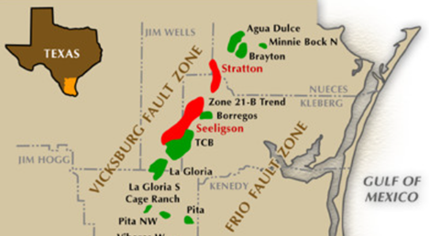
5. Study Area around Corpus Christi, Texas
Stratton Field Levey et.al (1994), Hardage, 1996
Notes:
The Stratton seismic survey is located west of Corpus Christi Bay, as shown here. The approximately 70 x 20 mile area, labeled 268331, is the area a set of lightning-derived rock property and lightning attribute volumes were generated for this talk. This area includes both the BEG’s Stratton seismic survey, and three geologic cross-sections published by Tom Ewing at the BEG.

Slide 28
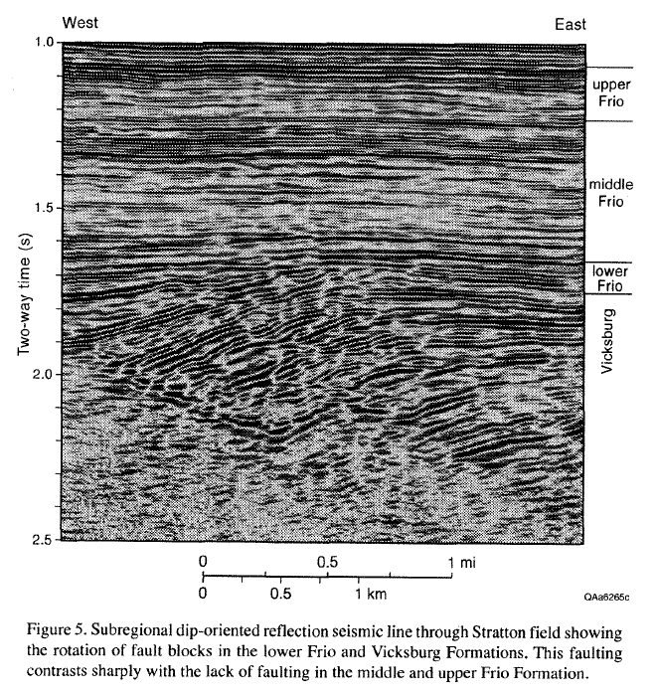
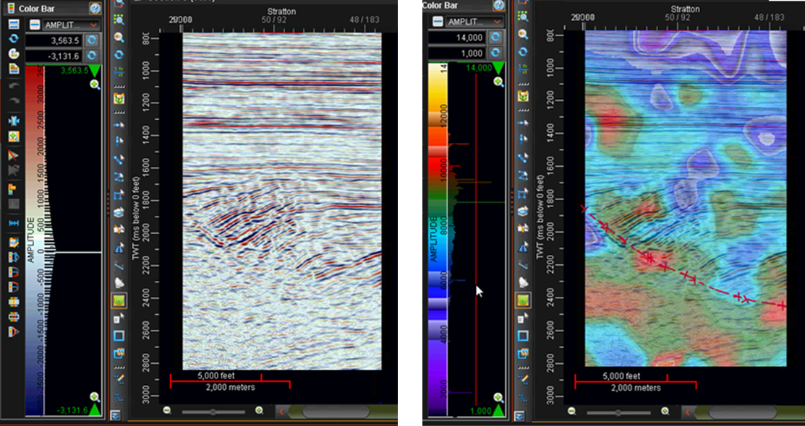
Stratton Field calibration, South TX.
Copyright © 2019
Dynamic Measurement LLC.

Slide 29
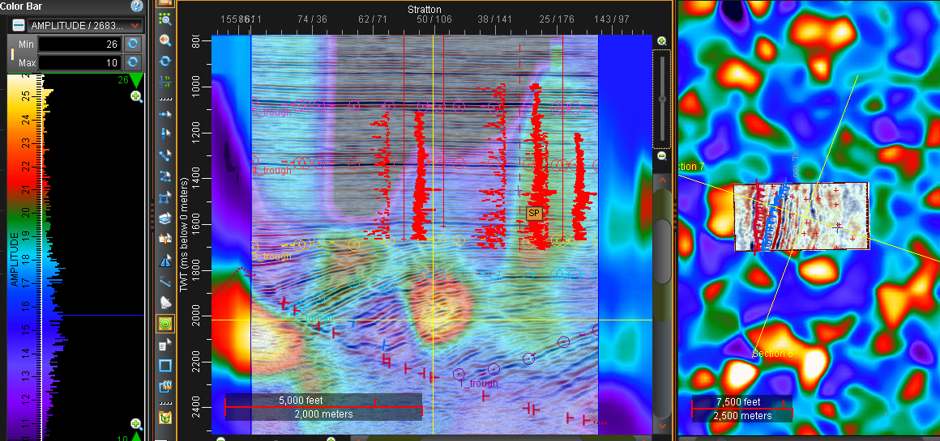
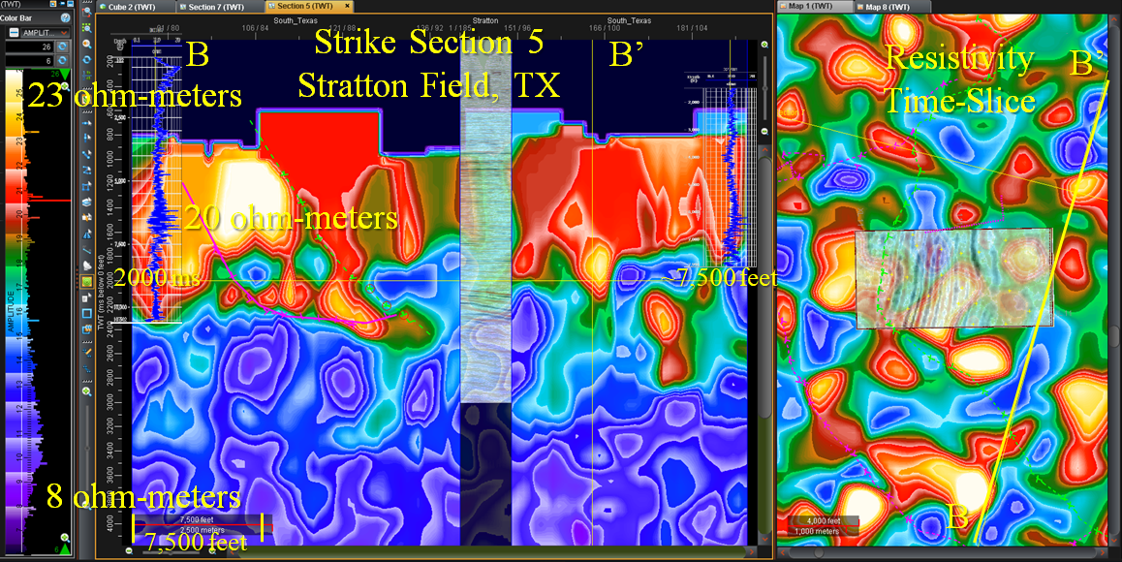
Resistivity Log Calibration, Stratton Field, South TX
Copyright © 2019
Dynamic Measurement LLC.

Slide 30
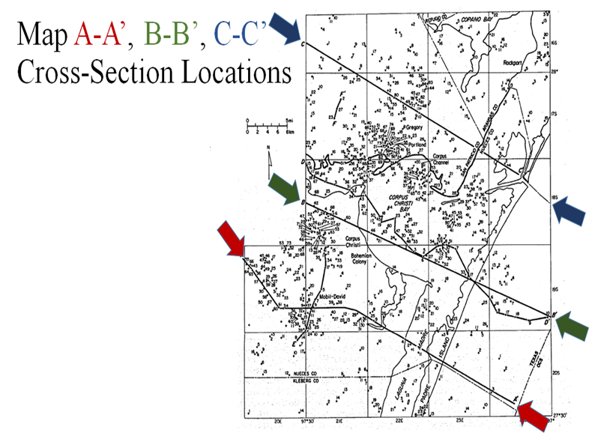
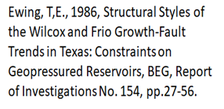
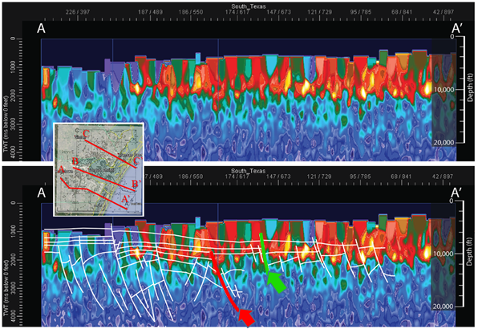
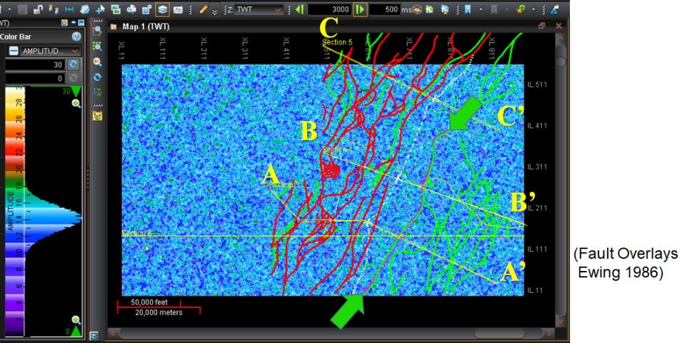
2016 Lightning-Derived Resistivity Cross-Sections Match Geology on 1986 Ewing Interpretation Overlay
Copyright © 2019
Dynamic Measurement LLC.

Slide 31
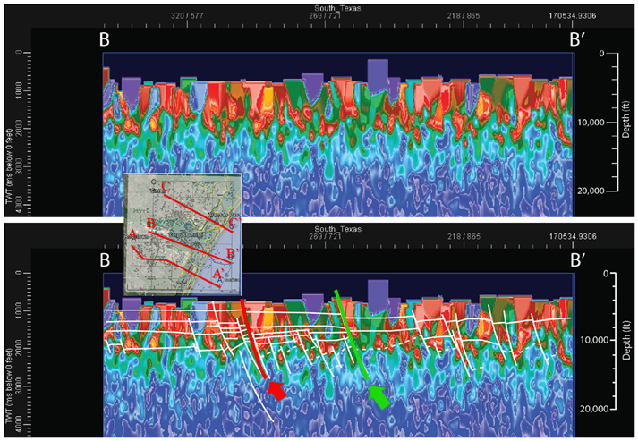
Regional Apparent Resistivity Analysis, South TX
Copyright © 2019
Dynamic Measurement LLC.

Slide 32
Apparent-Resistivity extension of Ewing (1986) A-A’ through Stratton seismic data
A
A’
Copyright © 2019
Dynamic Measurement LLC.
SunCity RockOn Rock Club 32
Notes:
Because of the time available in this type of professional presentation, the next series of slides will be stepped through very quickly. Each slide shows the same sections as is shown here. The time-slice section on the upper right covers the 268331 area defined in slide 15 above. There are three faults, which were picked on the apparent-resistivity cross-sections, to show the fault trend orthogonal to cross-section A-A’. The time-slice is at 2500 milliseconds. The time-slice also shows the location of the extension of the A-A’ apparent-resistivity cross-section, in the bottom panel, which starts at the west side of the area, goes east through the Stratton survey, northeast to A, along A-A’ to A’, and then southeast to the corner of the area. The upper right cross-section is a zoom across the western portion of the bottom section. The black vertical line at the eastern edge of the horizontal scale in the bottom of the upper-right cross-section shows where this line bends to the northeast. Location of the Stratton seismic data is highlighted with a yellow arrow on each section. The attribute shown in all three windows of this display is apparent resistivity. The next 18 slides will show 18 lighting derived attributes along vertical and horizontal cross-sections at these same locations.

Slide 33
Lightning Attributes - Spike - 1 of 18 Attributes
(position of strike)
Notes:
The spike volume gives a depth value from Peak Current to the location of each strike. This display shows the depth location of each lightning strike that falls right along the lines or the time-slice cross-section. Note, there are strikes on adjacent lines, which are interpolated in three-dimensional space to create the differences seen on these various lightning-database-derived rock property and lightning attribute volumes.

Slide 34
Lightning Attributes - Peak Current – 2 of 18
(kiloamperes)
Notes:
The absolute value for all strikes (kiloamperes) were binned, averaged, posted at their calculated depth, interpolated, turned into a SEG-Y volume, and loaded into Landmark Graphics’ DecisionSpace Geoscience (DSG) software package. The color scale selected was very smooth, so markers were placed in the color scale to highlight differences. The relationship with the picked faults across the Stratton survey in the upper left display are very compelling.

Slide 35
3 of 18 Lightning Attributes - Energy
A
A’
A
A’
(milliampere-seconds)
Notes:
The Energy Attribute volume is determined by calculating the area under the curve defined by zero to Peak Current across the measured Rise-Time and Peak Current to zero across the measured Peak-to-Zero: ([pc * (rt + pz)/2] milliampere-seconds). As expected, the deeper the values the larger the lightning-derived energy values. This is because it takes more energy to bridge a larger atmospheric dielectric and capture deeper information. The units for this lightning attribute are milliampere-seconds, and range from 0 to 600 milliampere-seconds for this data set in South Texas. This same attribute ranges from 0 to 1,000 milliampere-seconds in a desert in California.

Slide 36
4 of 18 Lightning Attributes - Frequency
A
A’
A
A’
(kilohertz)
Notes:
The frequency attribute is derived by calculating the inverse of the wavelength (1/[Rise-Time+Peak-to-Zero_Time]). This is the dominant frequency of the lightning pulse (kilohertz). The color bar selected is the color bar Seiscom Delta first used to display the Instantaneous Frequency seismic attribute. Note on the upper left section there is a low frequency anomaly corresponding to the faults interpreted on seismic data.

Slide 37
9 of 18 Lightning Attributes - Apparent Permittivity
A
A’
A
A’
(microfarads per meter)
Notes:
The distributed capacitance of an earth volume computed from Rise-Time and Peak Current. Usually supplied only as a volume, the Apparent Permittivity scale is in microfarads per meter. This is one of two rock property volumes calculated from the lightning database. Again, note how well the Stratton faults are imaged by this lightning attribute.

Slide 38
11 of 18 Lightning Attributes - Rise Time
A
A’
A
A’
(microseconds)
Notes:
Rise-Time of the strike in microseconds is one of the basic measurements in the lightning database. A standard product has a map, as an XYZ file, and a volume. The Rise-Time scale is in microseconds, which is the time it takes to go from background electrical noise to Peak Current in microseconds, averaged over each cell in the project data volume.

Slide 39
17 of 18 Lightning Attributes - Tide Gradient
A
A’
A
A’
(first derivative of Tide)
Notes:
Earth Tide Gradient is the first derivative of the Earth Tide, or the maximum ebb and flow of the Earth Tide. This attribute is the density of strikes at the tide gradient. There is a definite relationship with the Vicksberg Expansion on the Stratton section in the top left, and a hint at Frio and Oligocene-Pleistocene expansions in the regional section going through A-A’ on the bottom. Compare this bottom section to the drawing on slide 17. There is much more work to be done to understand the relationships between these various lightning-derived attributes and geology.

Slide 40
17 of 18 Lightning Attributes - Tide Gradient
A
A’
A
A’
(first derivative of Tide)
Notes:
Earth Tide Gradient is the first derivative of the Earth Tide, or the maximum ebb and flow of the Earth Tide. This attribute is the density of strikes at the tide gradient. There is a definite relationship with the Vicksberg Expansion on the Stratton section in the top left, and a hint at Frio and Oligocene-Pleistocene expansions in the regional section going through A-A’ on the bottom. Compare this bottom section to the drawing on slide 17. There is much more work to be done to understand the relationships between these various lightning-derived attributes and geology.

Slide 41
18 of 18 Lightning Attributes - Total-Wavelet Time
A
A’
A
A’
(microseconds)
Notes:
The last attribute shown here, Total-Wavelet Time, is the sum of Rise-Time + Peak-to-Zero Time. The attribute is measured in microseconds, and appears to have a relationship to faulting, as shown with the Stratton seismic data in the upper left display. This 18 slide introduction to lightning-database-derived rock property and lightning attributes introduces a significant new set of data volumes which can be generated anyplace the data is available. In the U.S. and Canada, these volumes can be generated anyplace out to at least 300 foot water depths. Over the rest of the world, there is the GLD-360 database, which allows creation of 10 of these attributes out to water depths of at least 300 feet. These lightning attribute data volumes provide a new way to evaluate the geology of the world at the surface and from about 4,000 foot to 25,000 foot depths.

Slide 42
Dynamic Identifies Lightning Risk Points
Geologic Impact on Strike Locations
Cross-Plotting randomized lightning strikes vs. recorded locations shows there is a geologic effect to strike locations.
Copyright © 2019
Dynamic Measurement LLC.

Slide 43
Another Texas Example
2-D Resistivity Survey ties Lightning-Derived Resistivity Cross-Section
Notes:
Dynamic Measurement started because a Commercial Real Estate Developer noticed lightning striking at the same place on his property on the east flank of the Hockley Salt Dome three times with about a 12 month interval between each set of strikes. The west side of upper left shows the Hockley Dome. It also shows a fault which goes to the northeast from the dome, cutting highway 290. There has been damage to roads at the surface along this fault. So a resistivity survey was collected to see if the impact of the fault could be seen in the subsurface. Results were published in The Leading Edge in February of 2011, as shown in the resistivity cross-section at the top. One of Dynamic’s Geophysicists, Louie Berent, pulled a lightning-derived apparent-resistivity section out of a lightning analysis project over the Hockley Dome along this same profile. The result is shown in the apparent-resistivity section at the bottom. There is a significant fault, in black, interpreted which matches the location of the fault interpreted on the 136-foot-deep traditional resistivity section. The depths of the lightning-derived apparent-resistivity section are believed to be from 5,000 feet to about 25,000 feet. Note that this section was generated before Dynamic started muting the data above the first valid data (data onset). Also note that there are 9 other faults interpreted on this cross-section. These faults carry from section to section, and can mapped over a large area, demonstrating how lighting analysis can create a geologic framework for any area with limited subsurface control.

Slide 44
5. Louisiana Example
Density Map & Rate-of-Rise-Time Map
Notes:
This slide is from a lightning analysis project in Iberia Parish, Louisiana. It nicely illustrates how some maps, like Lightning Density on the left show areas of high and low lightning density. There are also lineaments on this map which relate to fault trends and shallow water. This map is not impacted by geology in the same way as the Rate-of-Rise-Time map on the right is. Rate-of-Rise-Time seems to be impacted by shallow fresh water, and in this case by salt domes which come up to the surface. The location of the three salt domes in this area are very evident on this display, as well as fresh water to the northeast of the two southeast salt domes. Lightning strikes are interacting with geology.

Slide 45
5. Michigan Example High Resistivity to SW on B-2 Horizontal-Slice with Oil & Gas Wells in Analysis Area posted (note lineaments)
Notes:
Lightning analysis response varies by area. This example was put together centered on the MTU cross-hole tomography well test site in the northwest portion of the Michigan Peninsula. The display is a horizontal apparent-resistivity section at about 2800 milliseconds. Wells from the Michigan Geological Survey are overlaid. Red wells are gas wells, which are located where the highest resistivities (reds and yellows) are on the time-slice section. Oil wells fall along lineaments and around one of the circular resistivity anomalies, as noted with the yellow interpretations. Dynamic Measurement needs to get the well logs, and to work on calibrating the vertical axes of the apparent-resistivity volume as well as the calculated apparent-resistivity values with the resistivity values on available well logs. This is part of the ongoing work of a startup operation.

Slide 46
5. Arizona Examples: Resolution Copper
NLDN Peak Current & Rise-Rate
Notes:
The last section of this presentation provides a highlight from four lightning analysis projects in Arizona, Louisiana, Michigan, and Texas.
This first example shows some lightning-derived map and volume displays across the multi-billion Resolution Copper Mine near Superior, Arizona. This first slide shows maps of NLDN measured Peak Current and derived Rise-Rate. The white structure is the approximate extent of the copper porphyry deposit. The red dashed outline on the two lightning attribute maps shows a halo around this display, and there are interpreted possible volcanic sills through the deposit. Dynamic Measurement will be doing more work with these data volumes and tying the results to ground truth from mining results.

Slide 47
Three Example SPOTSM Apparent-Resistivity Cylinders
3.14 sq. mi.
$5,850
12.57 square miles $9,600
0.03 square miles
$3,000
Notes:
One of the new capabilities Dynamic has developed is the ability to create lighting derived “check-shot” surveys, which are named SPOTSM (Strike Position Observation Trend) surveys. SPOTSM surveys can be created anyplace, quickly and inexpensively. Each survey is defined by a location and a radius out from that radius. These surveys cost 10% of the price of a D.NSEMSM (Dynamic Natural Sourced Electromagnetic Survey) for a 500 foot radius (0.03 square mile) survey, up to about the same price for a 2 mile radius SPOTSM survey. The same lightning-derived rock property and lightning attributes shown in the previous section are generated as circular maps and cylindrical volumes at SPOTSM locations.

Slide 48
Integrating Resistivity in Three-Dimensions
80 square miles $67,630
Notes:
SPOTSM Surveys provide an inexpensive way to check out the anticipated lightning attribute response for an area. These surveys can be followed up with a D.NSEMSM survey over the area in order to generate a regional geologic framework, or to tie into existing well logs, gravity, magnetic, magnetotelluric, 2-D seismic, geologic cross-sections, 3-D seismic, 4-D seismic, and other available geological and geophysical control.

Slide 49
Comparing NLDN and GLD-360 data
NLDN Density 1998-2015 & GLD-360 Density 2012-2015
Notes:
Dynamic Measurement did a comparison test of NLDN lightning density and GLD-360 density over the same area at Resolution Copper. The results are different, which is to be expected with VLF and LF/VLF sensors. However, the halo is similar from both lightning databases, as shown above. This gives Dynamic Measurement confidence we can accomplish this same type of analysis anyplace in the world out to about 300 foot water depths using the GLD-360 database.

Slide 50
5. California – Apparent Resistivity Sections

Slide 51
California – Apparent Resistivity Map

Slide 52
5. Geothermal Exploration, South UT.
Copyright © 2019
Dynamic Measurement LLC.

Slide 53
South Utah Interpretation
Copyright © 2019
Dynamic Measurement LLC.

Slide 54
Calibration with UGS Seismic Based Cross-Sections
Copyright © 2019
Dynamic Measurement LLC.

Slide 55
Animation of “Flower Structure” Interpretation
Copyright © 2019
Dynamic Measurement LLC.

Slide 56
5. Gold Exploration, Humboldt County, NV.
B
B
A’
A’
B’
B’
A
A
A
A’
B
B’
Copyright © 2019
Dynamic Measurement LLC.

Slide 57
North Nevada Interpretation Animation
Copyright © 2019
Dynamic Measurement LLC.

Slide 58
Imagine August Parties when there is a rain storm Watching Lightning over the Cedar Iron Mines

Slide 59
Lightning is tied to all aspects of the Earth’s Electrical System
Top Plate
Just as Geo-Magnetic-Hot-Zones attract more lightning strikes, they pull on electrical current during power transmission, which leads to Leakage
Powerline Leakage
Geo-Magnetic-Hot-Zones are where concentrated sub-surface currents interact with pipelines speeding up corrosion and impacting integrity.
Pipeline Corrosion
Base Plate

Slide 60
Plans for this technology:
Define aquifers;
Explore for undiscovered mineral deposits;
Map potential new geothermal deposits;
Predict where lightning strikes could start a forest fire among all of the dead trees on Cedar Mountain;
Optimize real estate development to avoid lightning strike concentrations;
Find areas needing cathodic protection along natural gas pipelines;
Identify areas where telluric and terralevis (shallow earth) currents are bleeding electricity off of high power transmission lines;
Earthquake prediction;
Locate places to look for unique rocks;
Etc.

Slide 61
D.NSEM Prices
Beaver County
Beaver | Area | Price | Per Unit
Acres | 1,805,485 | $232,350 | $0.13
Sq.Km. | 7,306 |  | $31.80
Sq.Mi. | 2,821 |  | $82.36
Iron | Area | Price | Per Unit
Acres | 3,093,510 | $280,000 | $0.09
Sq.Km. | 12,519 |  | $22.37
Sq.Mi. | 4,834 |  | $57.93
Iron County
Wash. | Area | Price | Per Unit
Acres | 2,102,048 | $244,920 | $0.12
Sq.Km. | 8,507 |  | $28.79
Sq.Mi. | 3,284 |  | $74.57
Washington County
TOTAL | Area | Price | Per Unit
Acres | 7,000,614 | $371,560 | $0.05
Sq.Km. | 28,331 |  | $13.12
Sq.Mi. | 10,938 |  | $33.97

Slide 62
SunCity RockOn & SURC have some of the best “rock hounding” available on planet Earth
27,270 year old volcanic flows
in Santa Clara

Slide 63
There are all types of rock waiting to be found

Slide 64
Acknowledgements:
Les Denham, DML Chief Geophysicist.
Kathy Haggar, DML Geologist.
Louie Berent, DML Geophysicist.
BYU Interns Dustin Northrop and R. Corbin Lewis.
Tom Ewing (BEG) for regional South Texas geology.
Bob Hardage (BEG) for Stratton seismic survey.
Andrea Nelson, for enduring the startup phase.
Thank You!
http://www.dynamicmeasurement.com/TAMU/191012_Lightning_Analysis_creating_geo-frameworks_SunCity_RockOn_Geology_Club.pdf
H. Roice Nelson, Jr., Geophysicist
cell: 713.542.2207
e-mail: roice@dynamicmeasurement.com
www.dynamicmeasurement.com
www.dynamicmeasurement.com/TAMU
www.dynamicmeasurement.com/LI
211 Baker Road #382
Barker, TX 77413
Office: 281.579.0172
2155 West 700 South #31
Cedar City, UT 84720
Fax: 435.267.2668
Notes:
I listed myself as the sole author because I live in Cedar City, Utah, and I am the only one who would be attending The Pacific Coast and Rocky Mountain Section of the AAPG meeting in Las Vegas. However, there are many people who contributed to the material presented, as listed here. Thank you for attending and thank you for your questions and comments and discussions about Dynamic Measurement technologies.

Slide 65
Abstract – Lightning Analysis: creating geo-frameworks
12 October 2019, 9:00 AM, H. Roice Nelson, Jr., a geophysicist from Cedar, B.S. Geophysics 1974 University of Utah, with over 48 years working in oil, gas, & mineral exploration, will speak at the SunCity RockOn Rock Club Meeting, Sun City Pioneer Center (Recreation Center), 1350 Flat Top Mesa Drive, Mesquite, NV 89034.
Geophysicists have used passive gravity, magnetic, and seismic measurements to understand the subsurface of the earth for decades. Dynamic Measurement has expanded these capabilities, developing and patenting ways to datamine electrical information in existing lightning strike databases in order to map faults, creating geo-frameworks of subsurface geology anyplace onshore and out to at least 100 meter (330 foot) water depths.
This presentation will review Dynamic’s lightning technologies, and show examples from lightning analysis projects in Texas, Louisiana, Michigan, Arizona, and California. The presentation will start with a review of how lightning analysis can help locate lodestone, fulgurites, smoky quartz, sunstone, topaz, volcanic and hydrothermal alteration, red and green beryl, etc. There will also be discussion of plans to use this technology to map mineral deposits, define aquifers, predict where lightning strikes could start a forest fire among all of the dead trees on Cedar Mountain, optimize real estate development to avoid concentrations of lightning strikes, predict areas needing additional cathodic protection along natural gas pipelines, identify areas where telluric and terralevis (shallow earth) currents are bleeding electricity off of high power transmission lines, and, most importantly to the rock club, identify new places to collect unique rocks.

