Slide 1
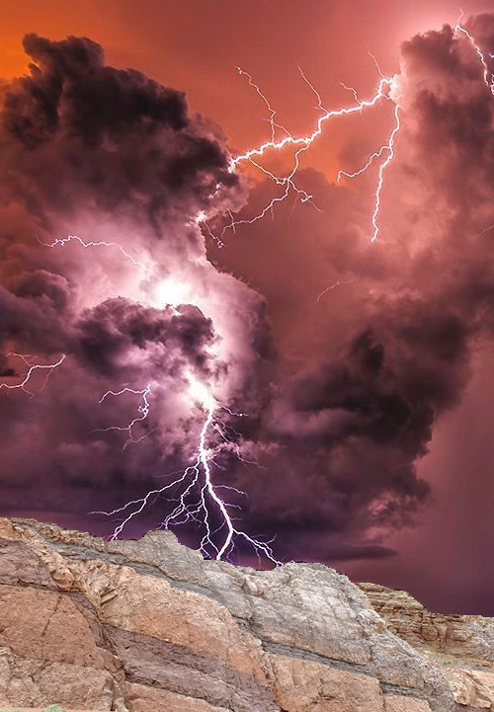
Dynamic Measurement LLC.
A Delaware LLC
Is seeking $600,000
for 14.18% ownership and a seat on the Board
To Build a New Branch In The Geophysical Services Industry
H. Roice Nelson, Jr., Les R. Denham, Dr. Jim Siebert, Michael F. Reed, Louis J. Berent, & Kathleen S. Haggar

Slide 2
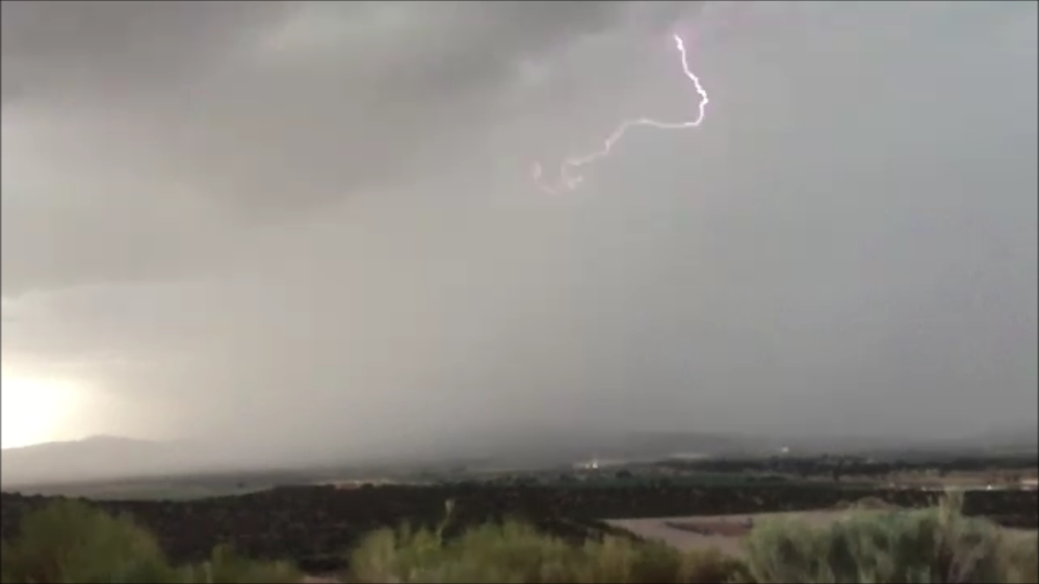
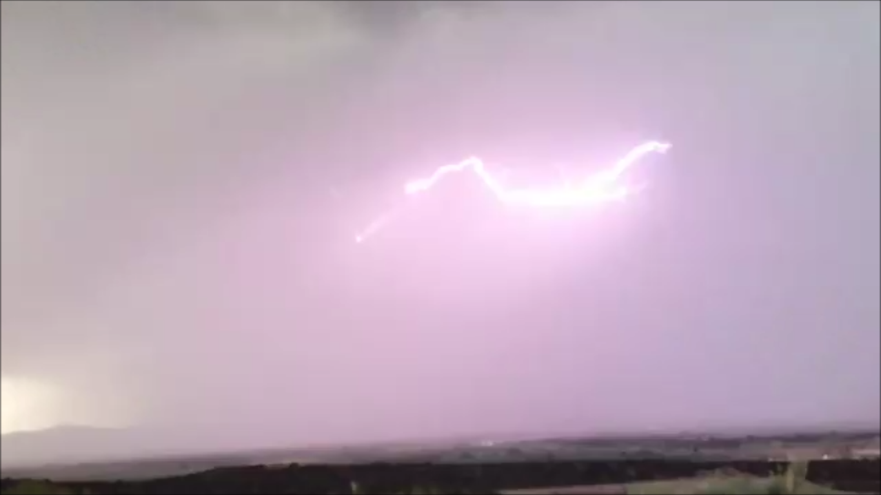
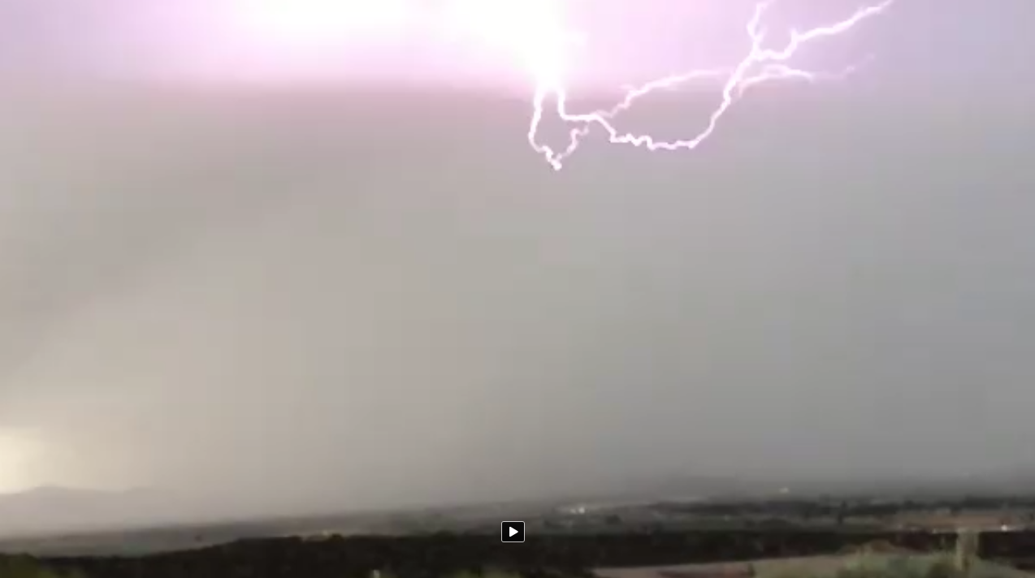
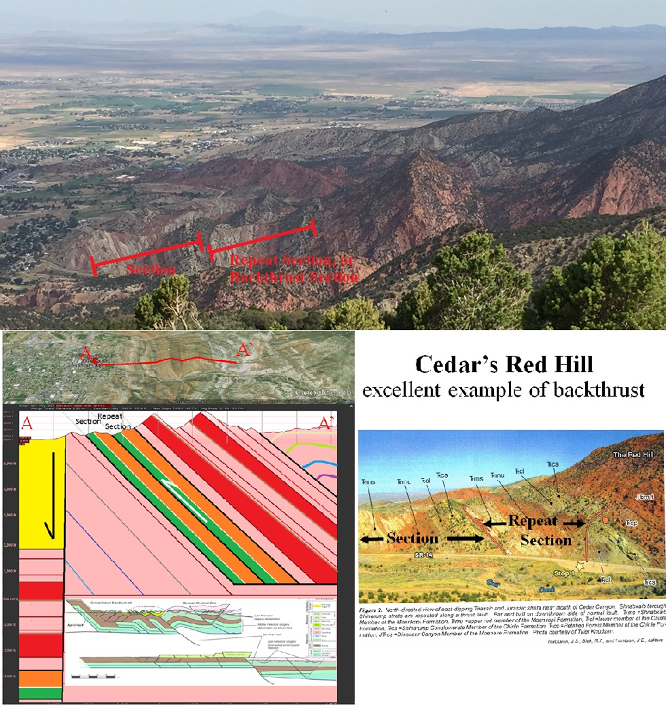
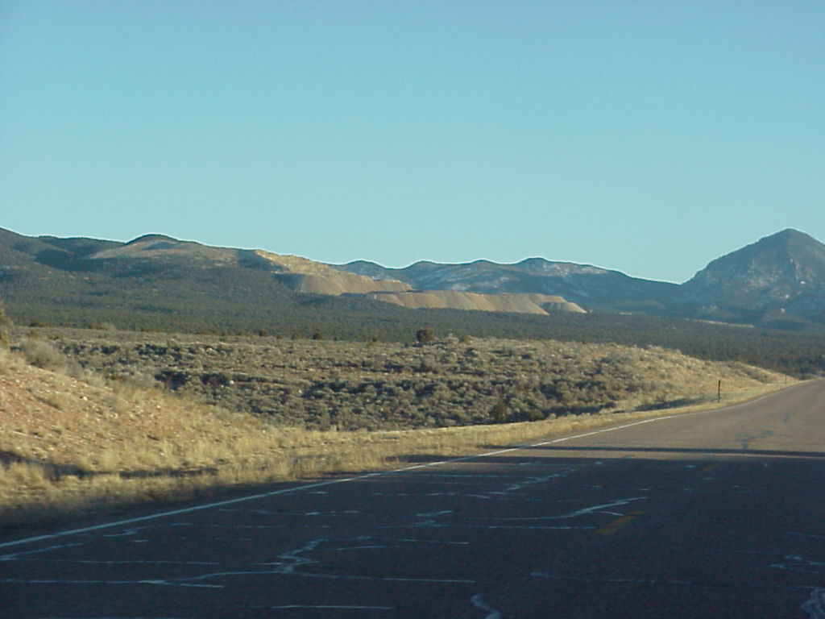
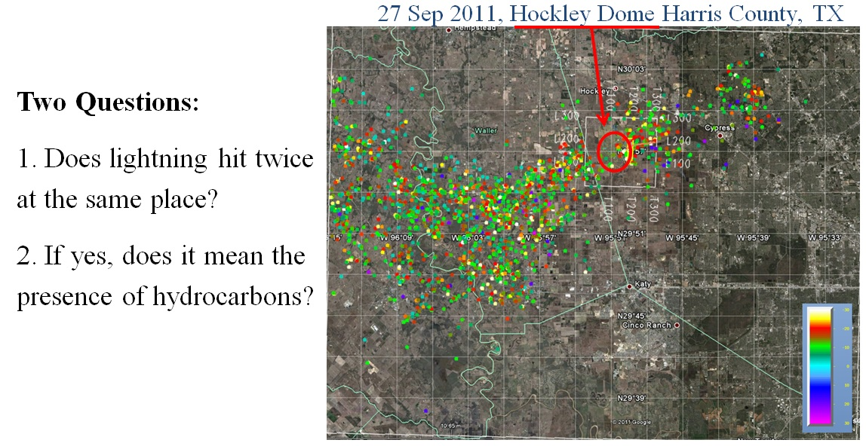
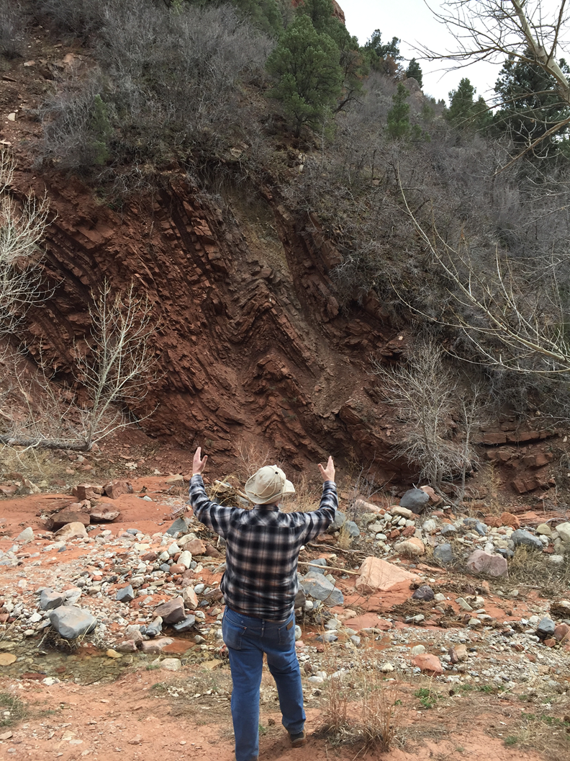
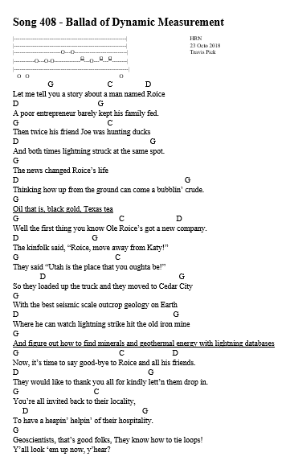
Ballad of Dynamic Measurement JaWS: Juice a Winning Startup

Slide 3
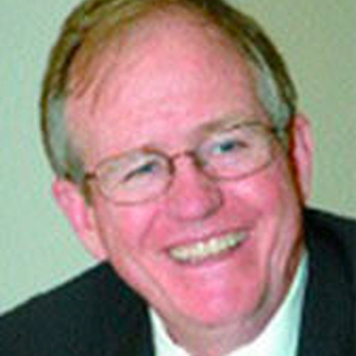
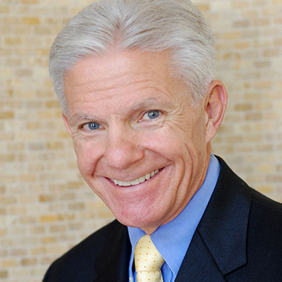
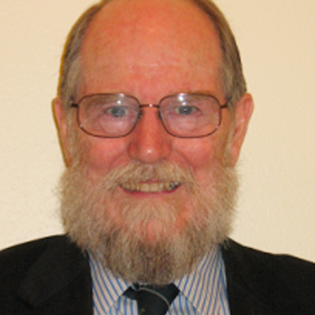
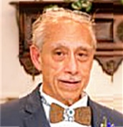
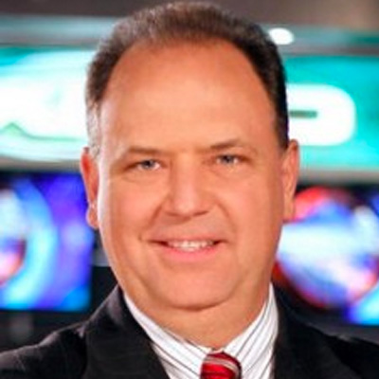
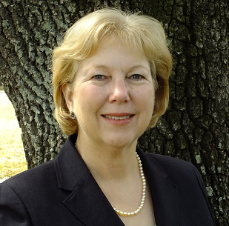
The Dynamic Measurement Team
H. Roice Nelson, Jr. President, Geophysicist, Co-Founder Landmark Graphics, Entrepreneur
Michael F. Reed Chief Operating Officer, CEO wind turbine company, MBA Northwestern
Les R. Denham Chief Geophysicist, Co-Founder II&T, Technologist, Programmer
Louis J. Berent V.P. Interpretation Business Development, Amoco, Maersk Oil, Berent Geophysical Consulting, Experienced interpreter
Dr. Jim Siebert Chief Meteorologist, Teacher, Fox News Houston Chief Meteorologist
Kathleen S. Haggar Chief Geologist, Chevron, Greenhill, wetland consulting, Dynamic Best Paper GCAGS 2 years in a row

Slide 4
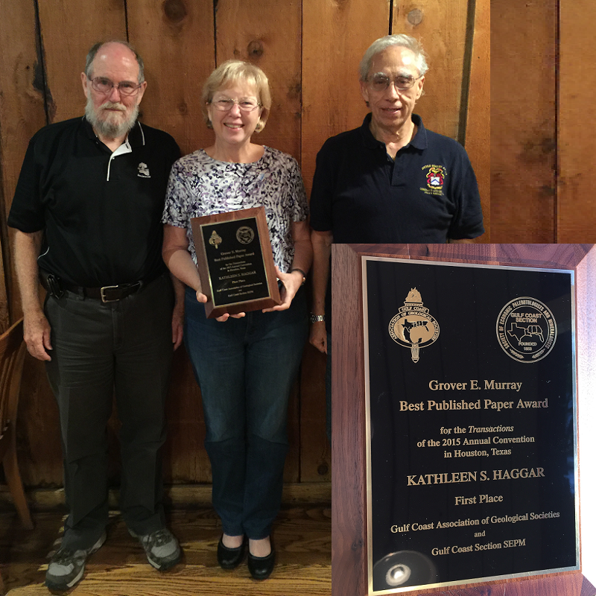
Technical Competence
Les Denham,
Kathleen S. Haggar,
Louis J. Berent,
H. Roice Nelson, Jr. Dynamic Measurement Best Paper GCAGS 2 years in a row

Slide 5
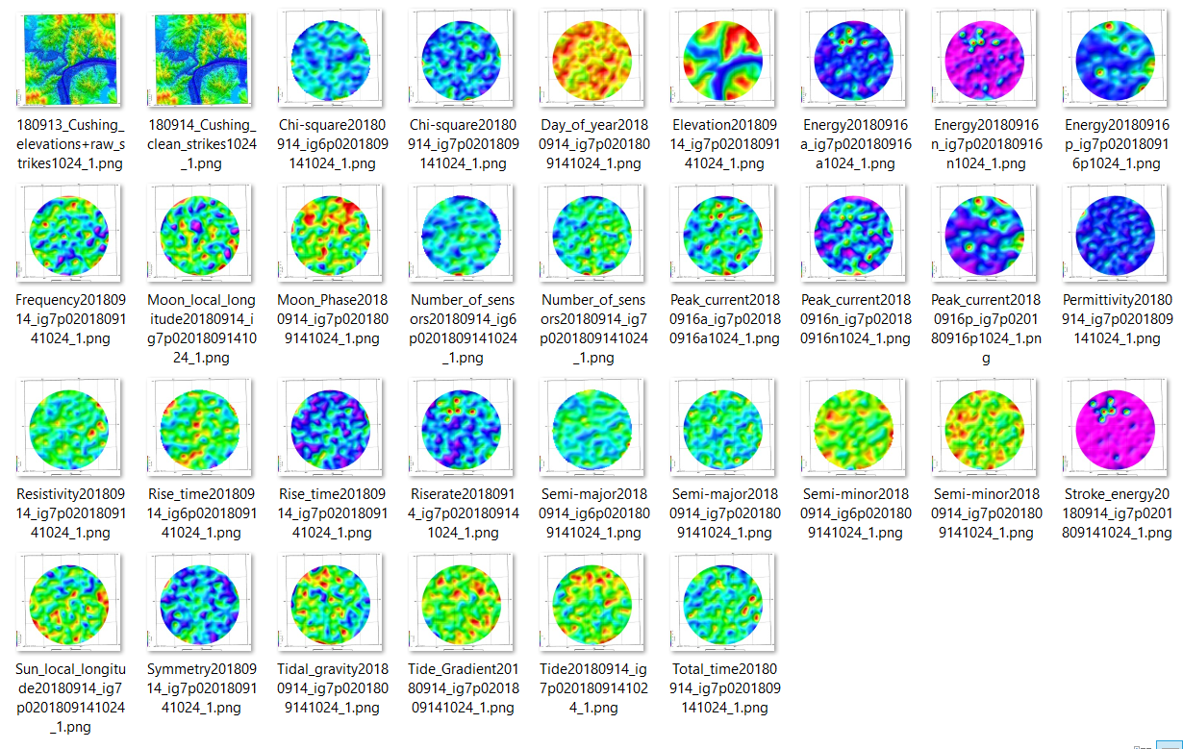
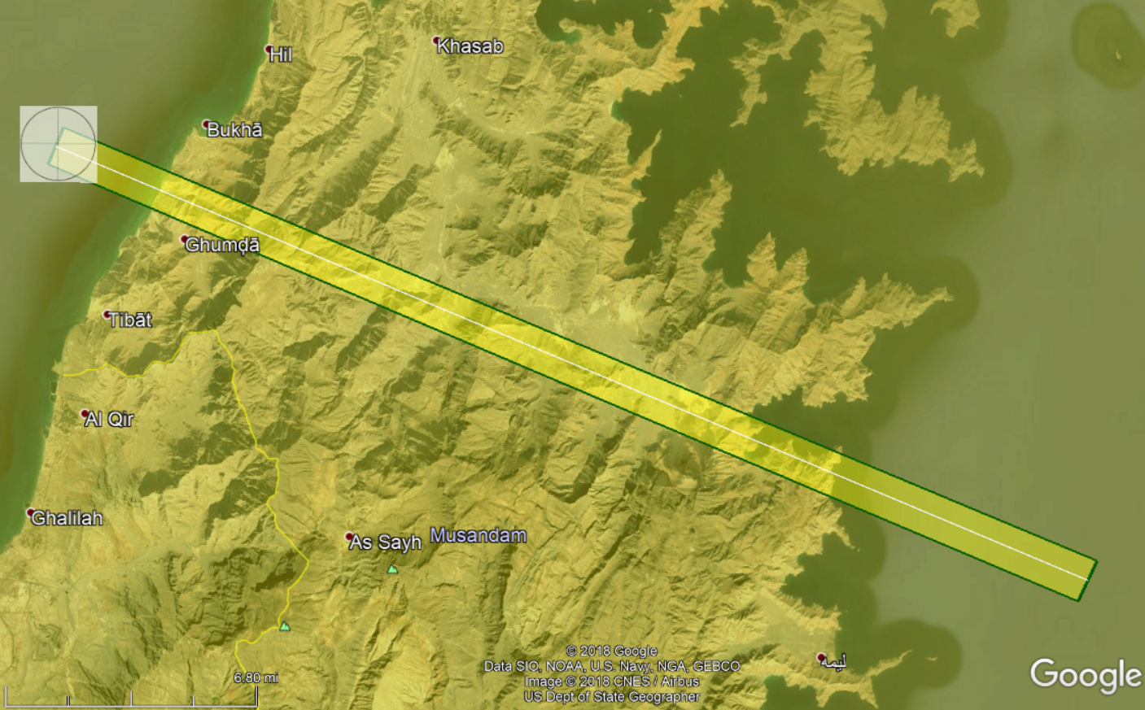
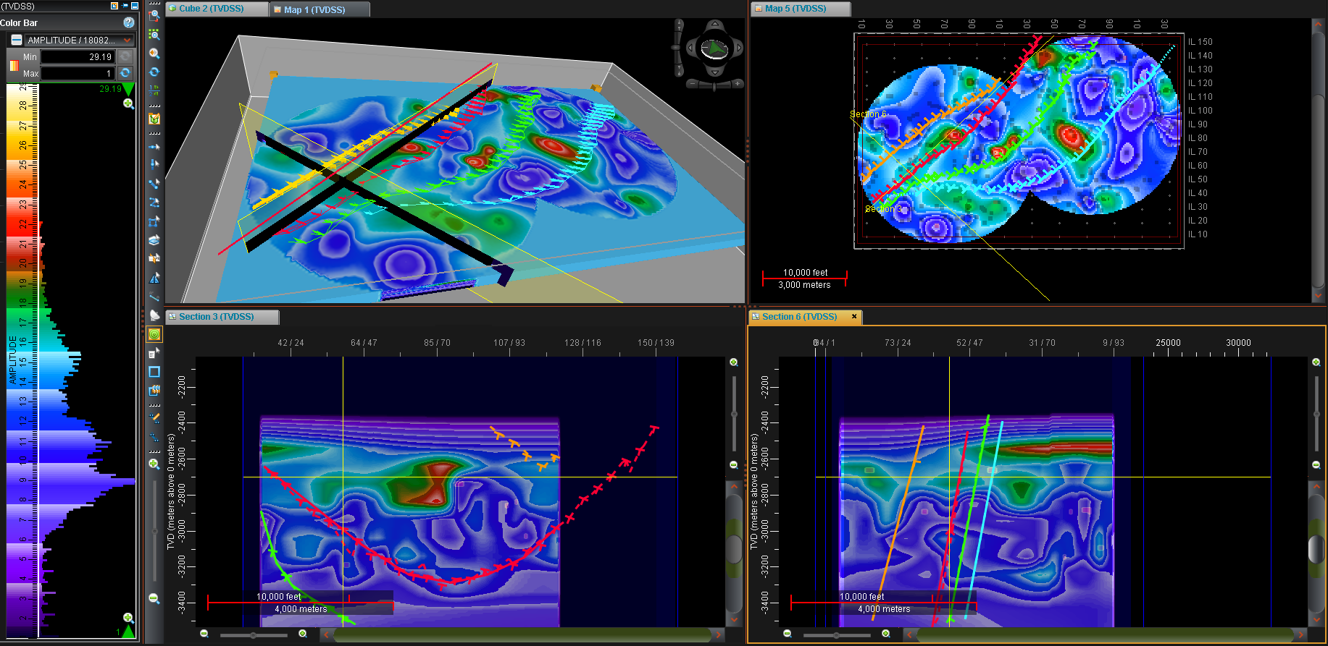
Dynamic Measurement Products & Services
SPOT^{sm}, LINE^{sm}, & d.NSEM^{sm} Maps & Volumes – available anyplace
U.S. & Canada
Resistivity, Permittivity, and 20+ Lightning Attribute Maps
Resistivity, Permittivity, and 20+ Lightning Attribute Volumes
50 meter Trace Spacing, or matching existing or planned geophysical surveys
Interpretation & Consulting Services
SPOT^{sm}
LINE^{sm}
d.NSEM^{sm}

Slide 6
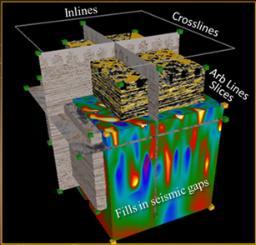
Why Lightning Analysis?
A new branch in the Geophysical Industry.
Cost. Less expensive, safer, & faster than competing geophysical data types.
Easily integrated with and calibrated to any existing 2-D/3-D geophysical data, along with available geological and geophysical data for oil & gas, mining (gold, silver, copper, sulfides, etc.), geothermal, water, and other natural resource exploration businesses.
3-D Integration
Resistivity Slice Permittivity Slice

Slide 7
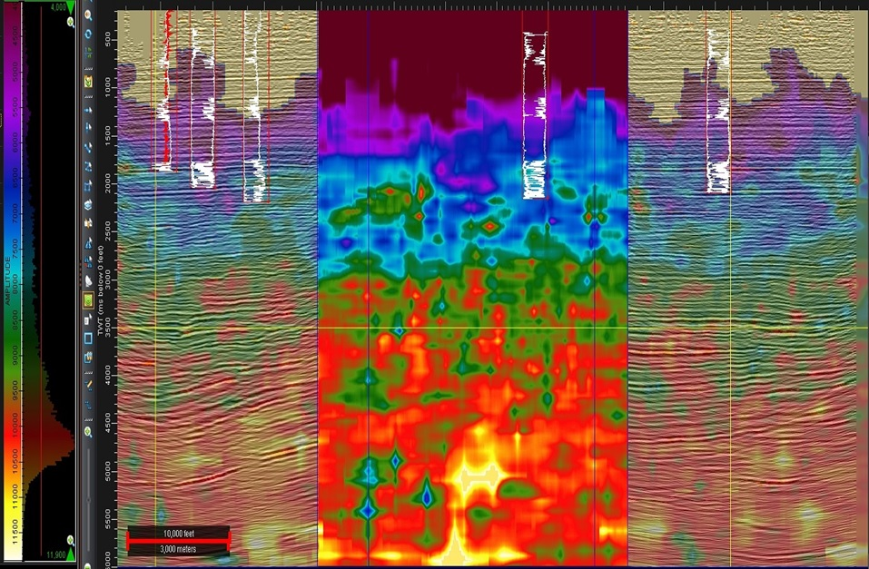
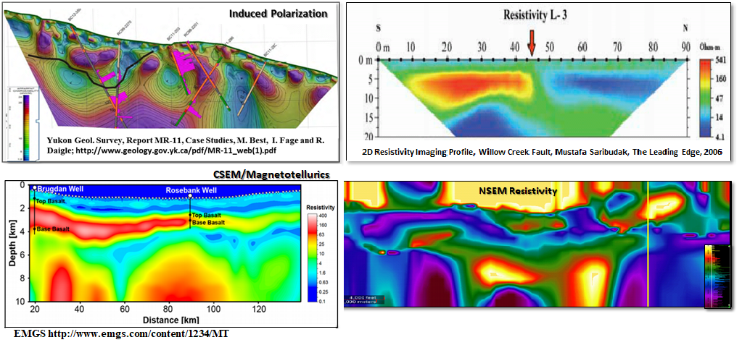
Why Lightning Analysis? continued
3-D
Lightning
IP
Resistivity
3-D
Seismic
2-D
Seismic
CSEM / MT
NSEM
Fills-the-gaps , tying various 2-D/3-D geophysical data sets to electrical rock properties (used to find predictive exploration signatures / sweet spots).
Structural & stratigraphic frameworks from reconnaissance mapping.
Passive energy source has more power than any other geophysical service.
No Permitting! No Notification! No Rights-of-Entry! No Boots on the Ground!
Easy workstation integration.

Slide 8
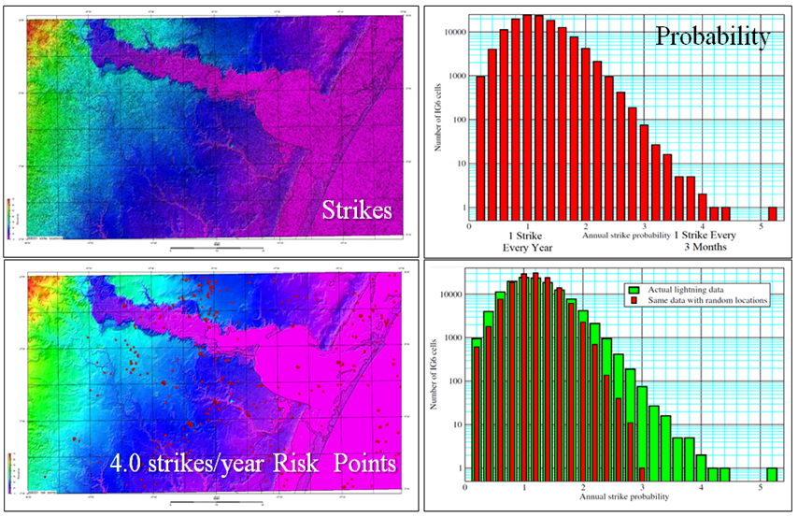
Dynamic Identifies HSE Lightning Risk Points
South Texas
Geologic Impact on Strike Locations
Cross-Plotting randomized lightning strike locations vs recorded locations shows there is a geologic effect to strike locations.
U.S. & Canadian patent pending technology aids planning facility locations.
Recorded
50 meter cells
with 4 strikes/year
Geology
Random

Slide 9
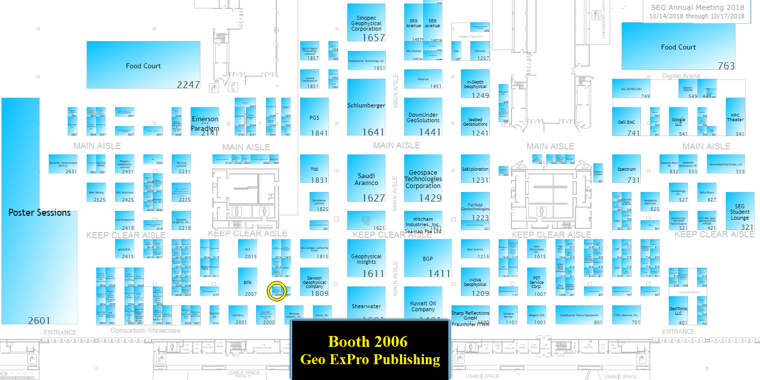
More of Dynamic Technologies
At the Friday Morning Workshop on Remote Imaging: 1 oral & 3 posters.
In October Geo ExPro Cover Article:

Slide 10
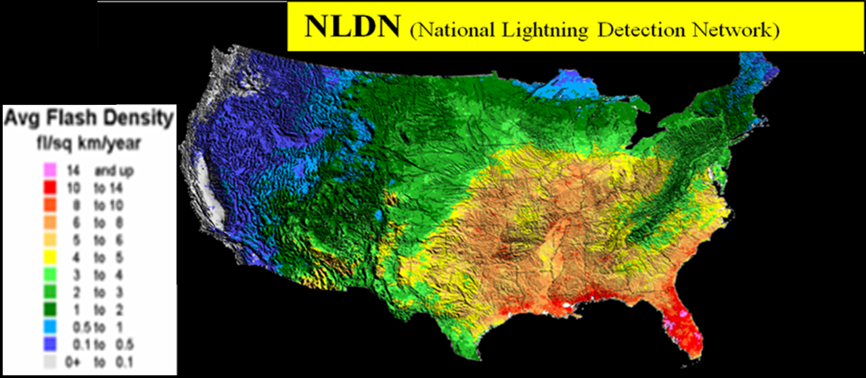
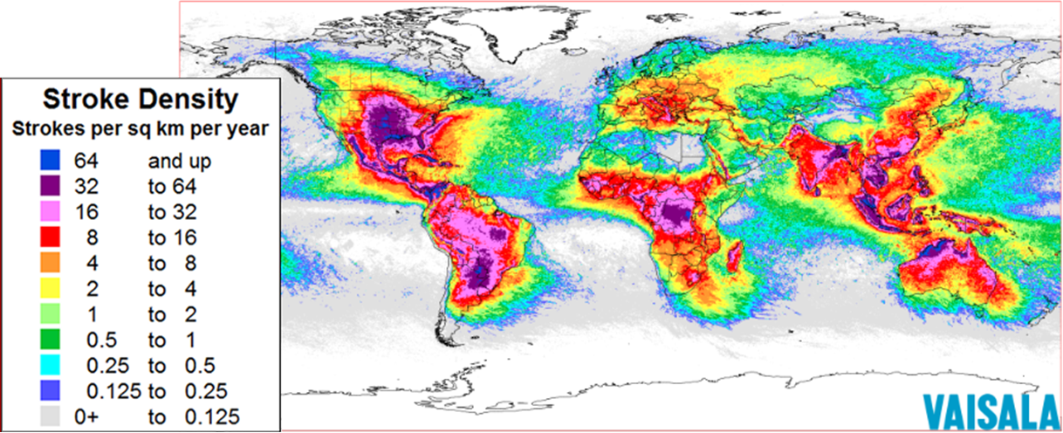
Dynamic Measurement’s Advantage
Exclusive License to Vaisala’s NLDN, NALDN, and GLD-360 Lightning Databases for Natural Resource Exploration.
2 Issued Patents, 1 Patent Pending, 4 Patents ready to submit when funded.
10 years of developing processing algorithms and analysis procedures.
35+ Case Histories from California to Florida and Texas to North Dakota.
Competent Technology Team that works well together.
Proven & tested entrepreneurs & managers.

Slide 11
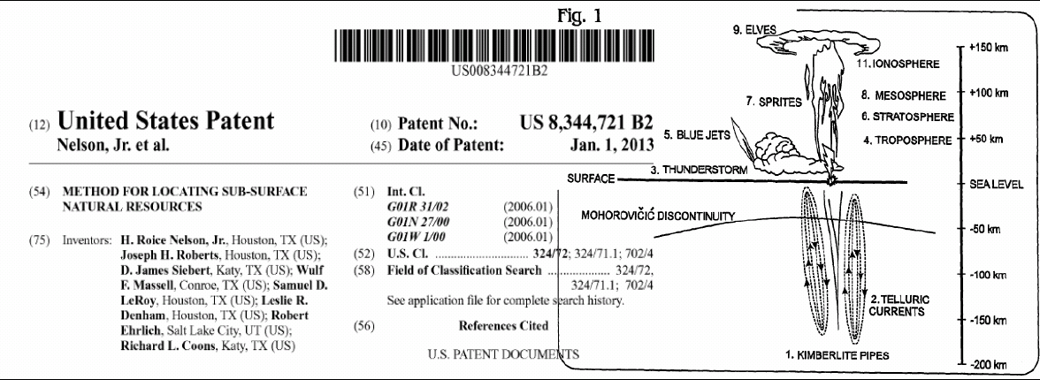
Dynamic has 1 Pending and 2 Issued U.S. Patents

Slide 12
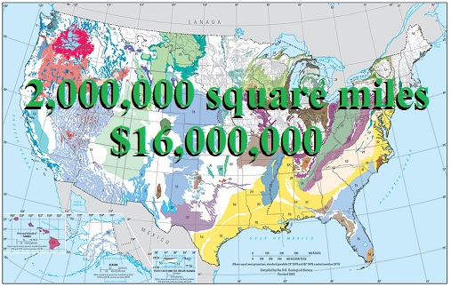
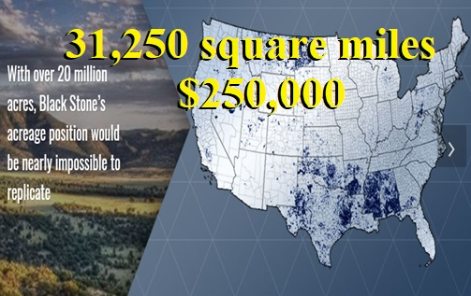
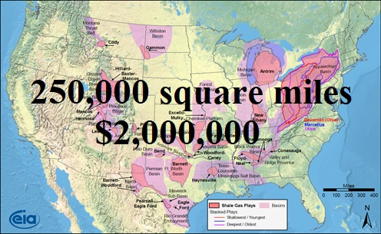
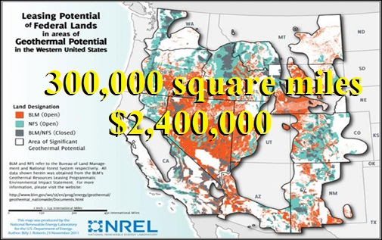
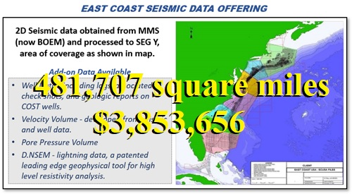
Market Size is Large: These examples list income for 1 (one) sale:
Oil & Gas Interpretation & High-Grade Opportunities:
Fault Frameworks & Migration Pathways.
East Coast BOEM.
Other Coasts: Gulf of Mexico; California; Cook Inlet; etc.
Shale Play Sweet Spots.
Deals: every Prospect shown at every NAPE.
National Oil Companies.
Minerals:
Oil Company Lease Positions
Blackstone Minerals.
Water:
Aquifers
Geothermal.

Slide 13
Business Plan
Dynamic Measurement LLC
$600,000 Investment for 14.18% Membership Interest
Pro Forma Income
Quarter | 4Q2018 | 1Q2019 | 2Q2019 | 3Q2019 | 4Q2019 | 1Q2020 | 2Q2020 | 3Q2020 | 4Q2020
Investment | $ 600,000
D.NSEM Square Miles | 500 | 1,650 | 3,100 | 6,500 | 12,250 | 19,000 | 24,000 | 33,000 | 42,000
Sales | $ 50,000 | $ 165,000 | $ 310,000 | $ 650,000 | $ 1,225,000 | $ 1,900,000 | $ 2,400,000 | $ 3,300,000 | $ 4,200,000
Total Income | $ 650,000 | $ 165,000 | $ 310,000 | $ 650,000 | $ 1,225,000 | $ 1,900,000 | $ 2,400,000 | $ 3,300,000 | $ 4,200,000
Pro Forma Expenses
Quarter | 4Q2018 | 1Q2019 | 2Q2019 | 3Q2019 | 4Q2019 | 1Q2020 | 2Q2020 | 3Q2020 | 4Q2020
Administration | $ 40,000 | $ 60,000 | $ 60,000 | $ 60,000 | $ 180,000 | $ 180,000 | $ 180,000 | $ 180,000 | $ 180,000
Research | $ 20,000 | $ 30,000 | $ 45,000 | $ 60,000 | $ 200,000 | $ 240,000 | $ 240,000 | $ 240,000 | $ 240,000
Patents & Tests | $ 112,800 | $ - | $ - | $ 60,000 | $ - | $ - | $ - | $ - | $ -
Operations | $ 215,000 | $ 147,000 | $ 185,000 | $ 242,000 | $ 283,000 | $ 198,000 | $ 198,000 | $ 198,000 | $ 198,000
Sales | $ 40,000 | $ 80,000 | $ 70,000 | $ 175,000 | $ 420,000 | $ 420,000 | $ 420,000 | $ 420,000 | $ 420,000
Total Expenses | $ 427,800 | $ 317,000 | $ 360,000 | $ 597,000 | $ 1,083,000 | $ 1,038,000 | $ 1,038,000 | $ 1,038,000 | $ 1,038,000
Quarter | 4Q2018 | 1Q2019 | 2Q2019 | 3Q2019 | 4Q2019 | 1Q2020 | 2Q2020 | 3Q2020 | 4Q2020
Total Income | $ 650,000 | $ 165,000 | $ 310,000 | $ 650,000 | $ 1,225,000 | $ 1,900,000 | $ 2,400,000 | $ 3,300,000 | $ 4,200,000
Total Expenses | $ 427,800 | $ 317,000 | $ 360,000 | $ 597,000 | $ 1,083,000 | $ 1,038,000 | $ 1,038,000 | $ 1,038,000 | $ 1,038,000
Cash Flow | $ 222,200 | $ (152,000) | $ (50,000) | $ 53,000 | $ 142,000 | $ 862,000 | $ 1,362,000 | $ 2,262,000 | $ 3,162,000
Cumulative Cash flow | $ 222,200 | $ 70,200 | $ 20,200 | $ 73,200 | $ 215,200 | $ 1,077,200 | $ 2,439,200 | $ 4,701,200 | $ 7,863,200

Slide 14
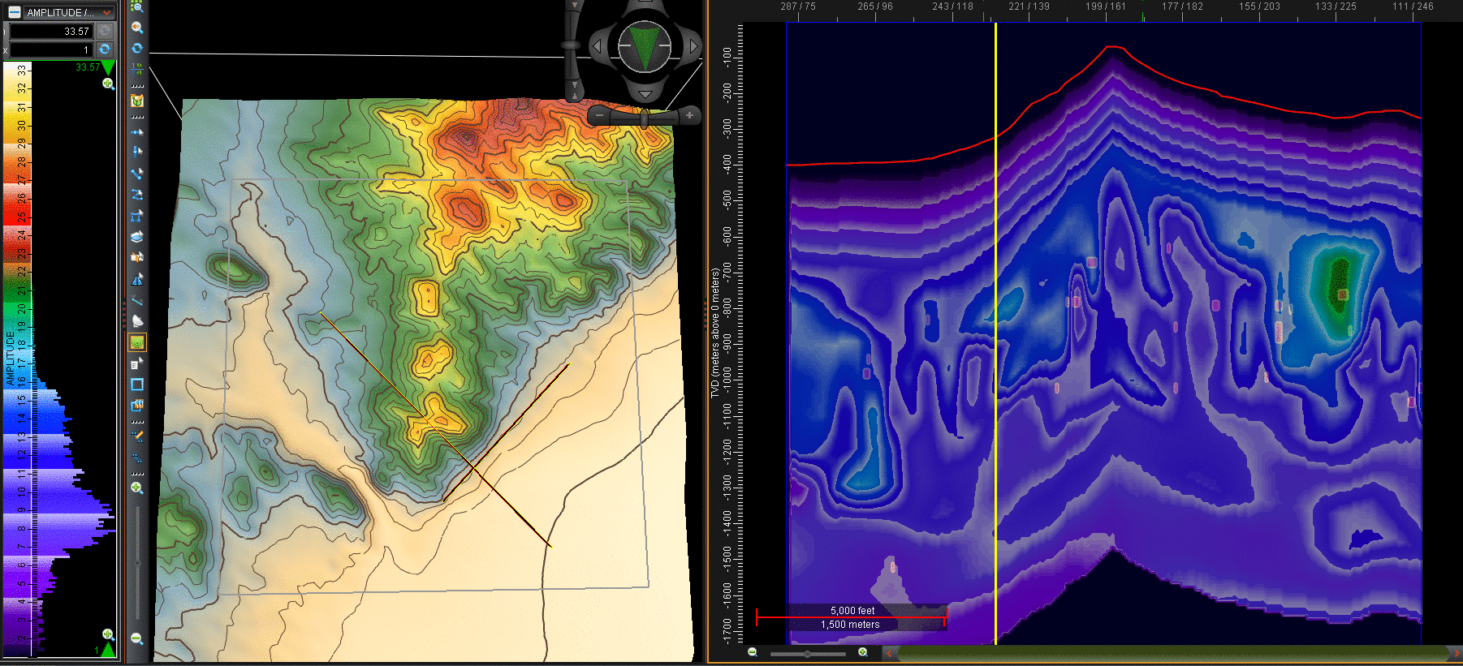
Great Basin Apparent Resistivity Volume

Slide 15
Contact Dynamic Measurement
http://www.dynamicmeasurement.com Website
roice@dynamicmeasurement.com Roice Nelson 713.542.2207
ljberent@dynamicmeasurement.com Louie Berent 832.352.3795

